Slide 1
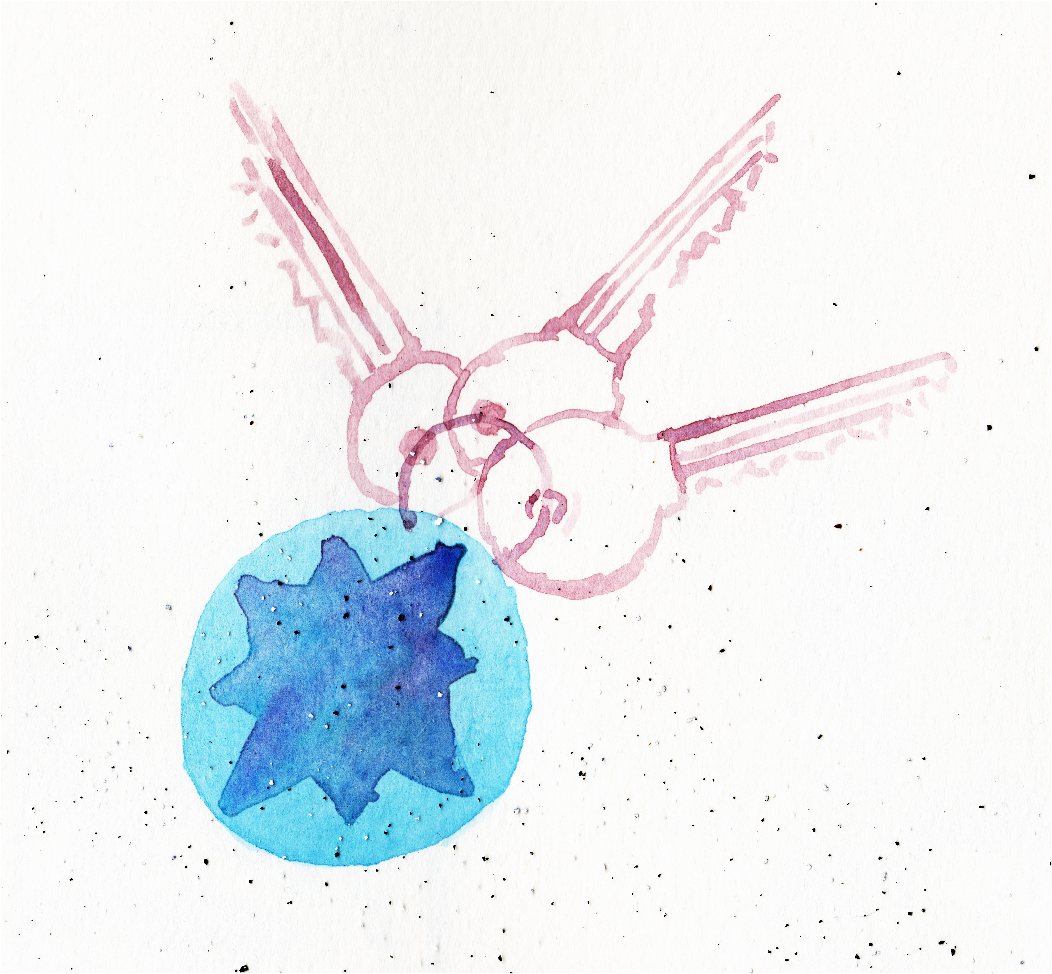
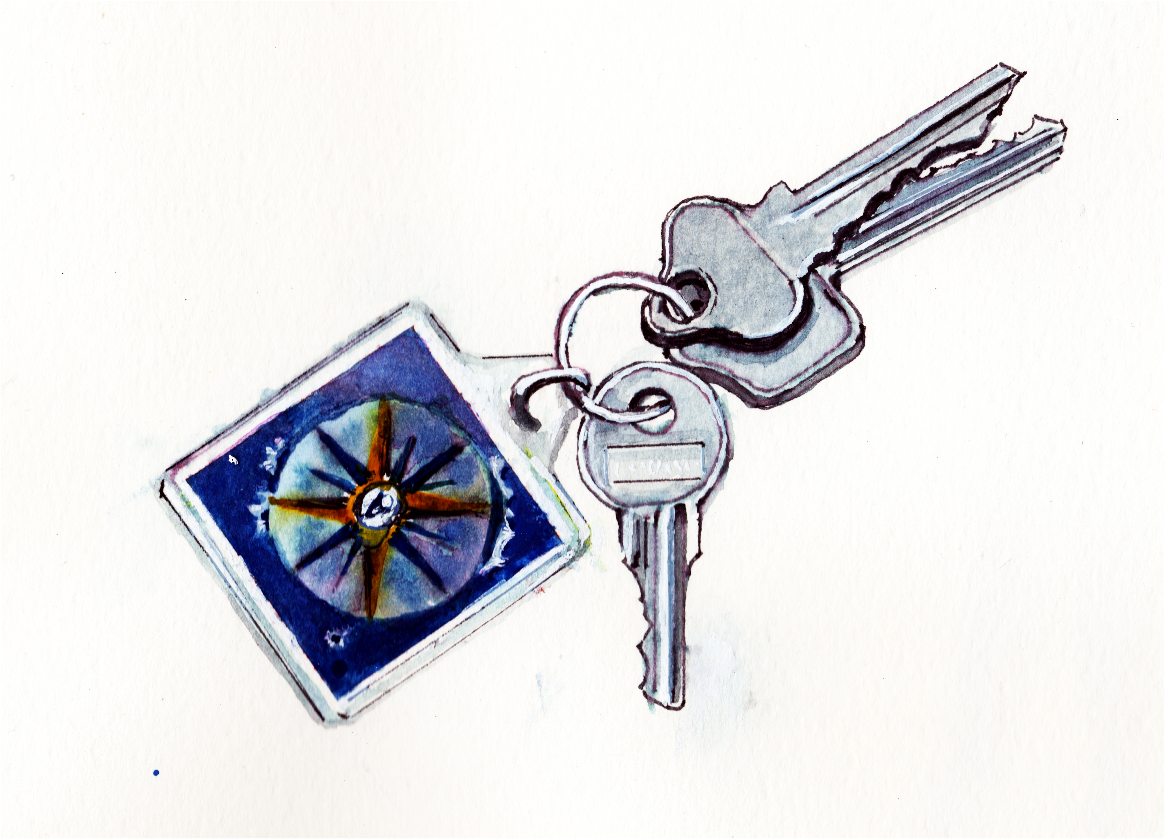
Visual Memory and Identifying Features
Drawings of Semi-lost Objects from Memory and from Life
Ron Gallagher

Slide 2
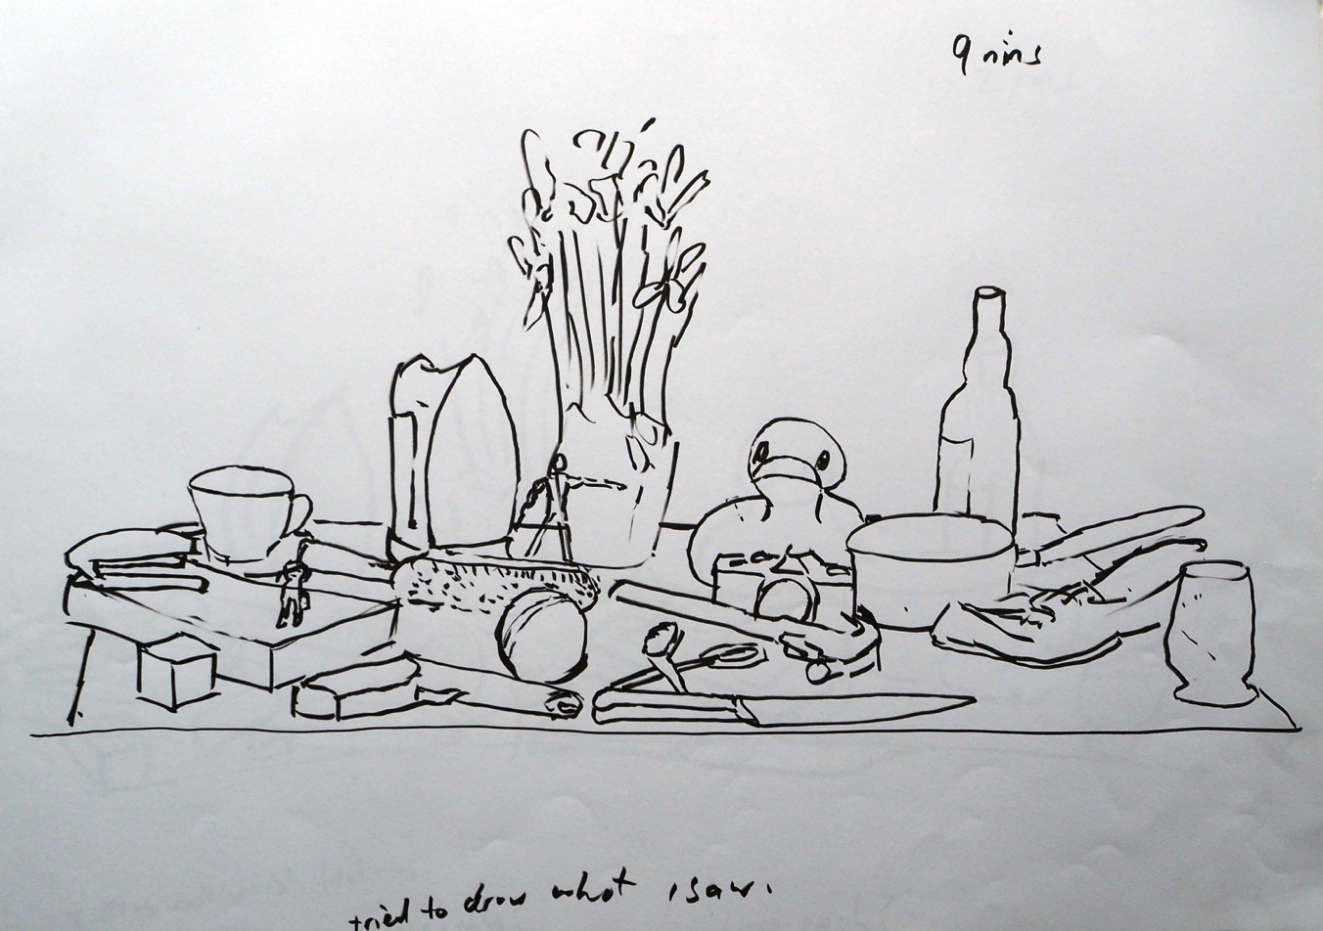
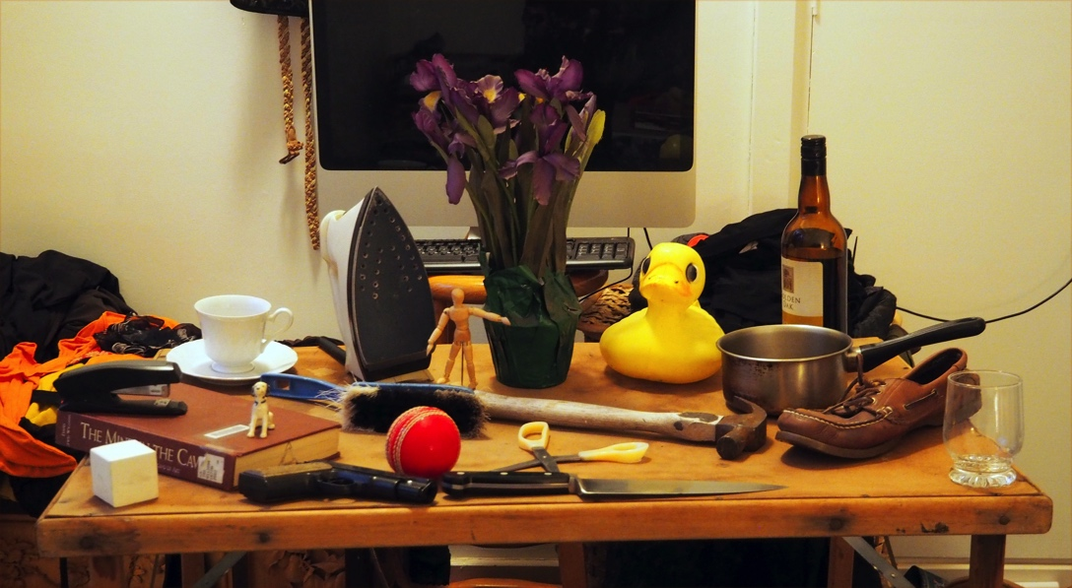

Slide 3
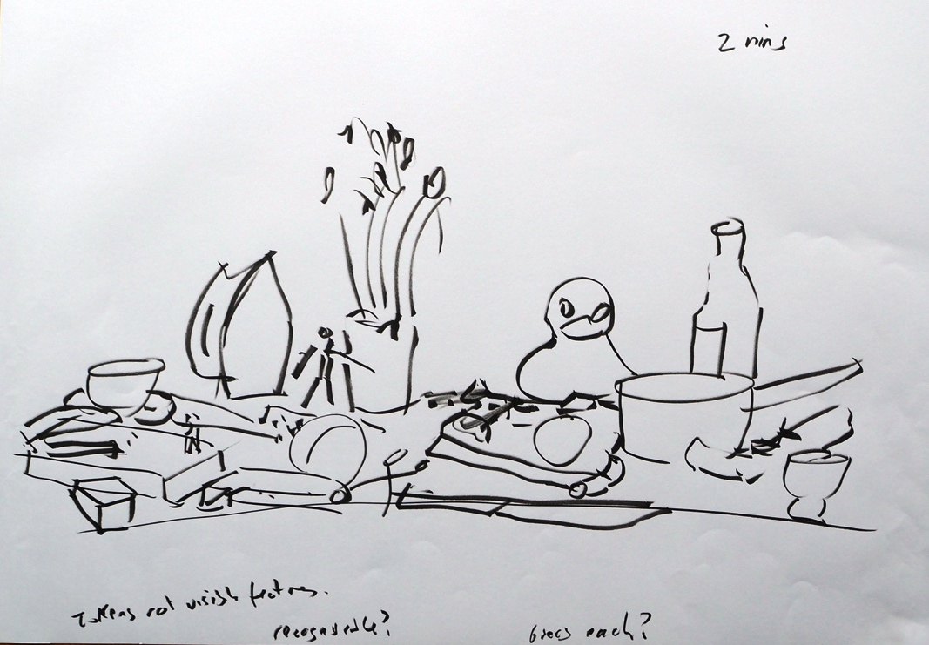
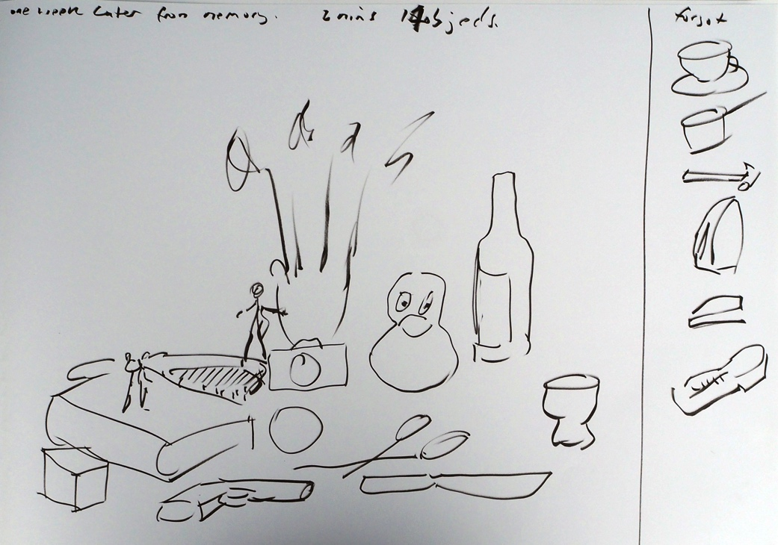
In the 2 minute drawing from memory some objects are more recognizable than in the 2 minute drawing from life.
From life
From memory

Slide 4
Commentary: My working hypothesis is that the reason we can see content in depictions is that the depiction triggers a sub-set of the recognition abilities that are triggered when we see the real object. In the case of line drawings, these triggers would need to be a rather abstract and there is some literature which supports the idea that such abstractions are superstimuli and/or activate hardwired abstraction features in the temporal lobe. If this is true it is likely that the recognition triggers for individual object type are related to the distinctive features of that object. With this in mind I conducted a series of drawing experiments designed to isolate the trigger features of objects. One of these experiments involved drawing 20 objects as quickly as possible. My idea was that if I drew the objects very fast I would need to focus on drawing key trigger features. One of the things I noticed when doing these very fast sketches was that the faster I got the more I was drawing from memory and not from life. I also did quick drawings of the 20 objects from memory a week after doing the live drawings. You can see in the slides (2 and 3) that in the 2 minute drawing from memory some objects are more recognizable than in the 2 minute drawing from life. This suggested to me that even when I was sketching from life I was sometimes drawing what I ‘knew’ rather than what I saw. Visual memory is the key to recognition as well as the key to drawing from memory. I decide to explore the role visual memory plays in drawing.

Slide 5
Drawings of semi-lost objects from Memory: I had previously speculated that when we search for objects, such as our keys or our shoes, we are scanning for distinctive features of those objects and these features are likely to be the trigger features that we might draw if we represented them. In order to test how this worked I visualized a number of semi-lost objects hidden in drawers and cupboard around the house (see slides 6-8): a torch, some keys, a US dollar note, a wooden figure of a man, a dice and a book spine from Philosophical investigations. I had not seen these things for a while and did a quick line drawing from memory of each of them to see how much I could remember of them (slides 9 & 10).
Immediately I realized how impoverished my visual memory was. I could not recall how the lettering on the book spine was organized or whether it was upper or lower case. I couldn’t remember what kind of keys were on the key ring or the layout of the US dollar. Everything I drew seemed like a guess, it seemed my visual memory wasn’t very visual. These simple line sketches were already highlighting the limitations of the visual memory which is crucial to recognition and identification. I began doing colour drawings of these objects because the colour of an object is a crucial feature when looking for it.
Sometimes I did several colour drawings of the same ‘lost’ object because as I was drawing I would remember a new detail, or conclude that something I had drawn was wrong. It is interesting to note that I felt that each object presented its own visual memory challenge. That is, each object had a structural feature (eg lettering, size, detail) that presented me with a new memory/drawing challenge. I have made a note of some of the issues that cropped up when I was trying to draw these objects from memory(see final slides). My struggle can sometimes be seen in the iterative sequence of sketches.

Slide 6
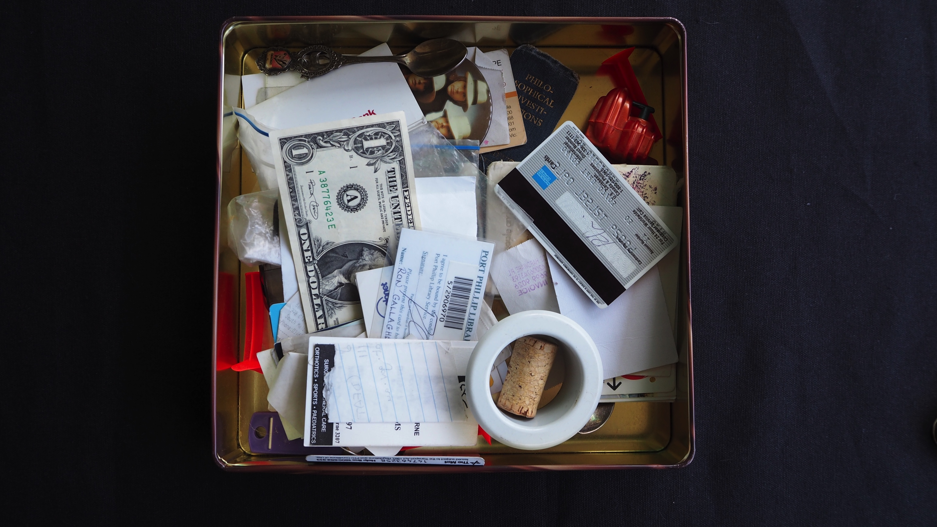

Slide 7
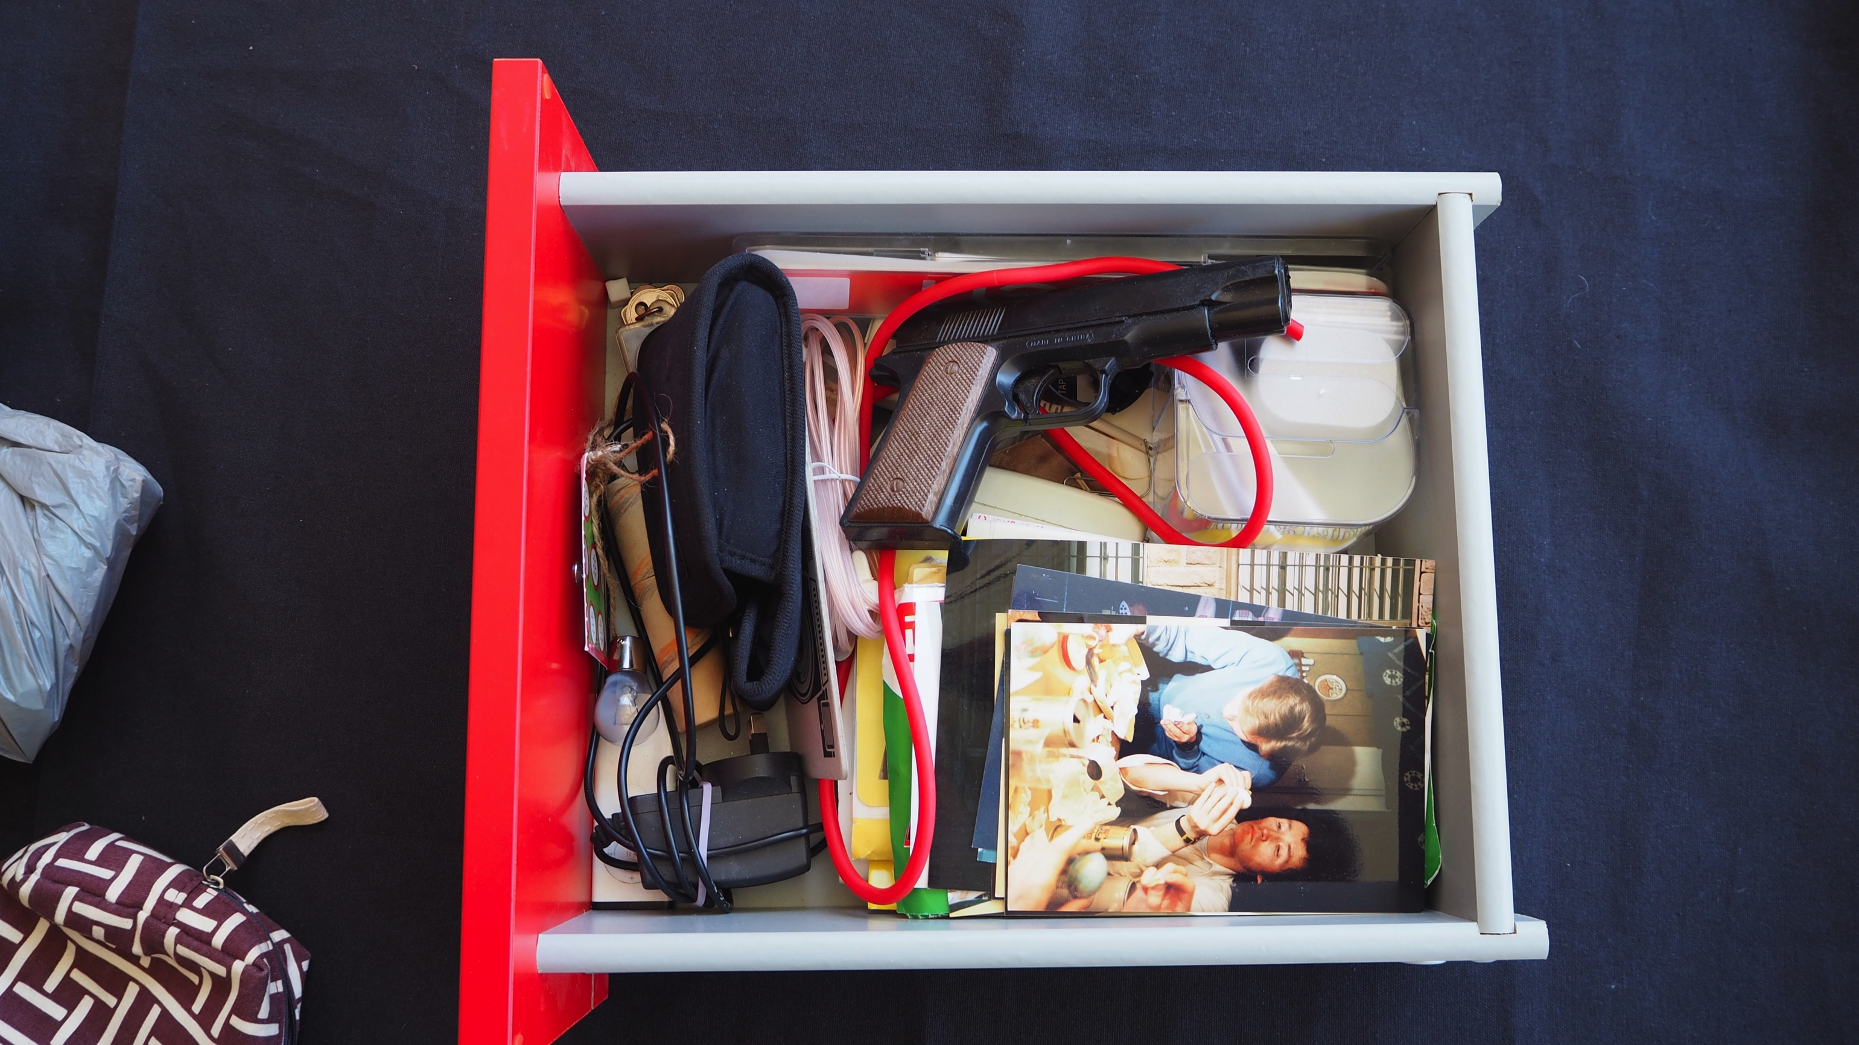

Slide 9
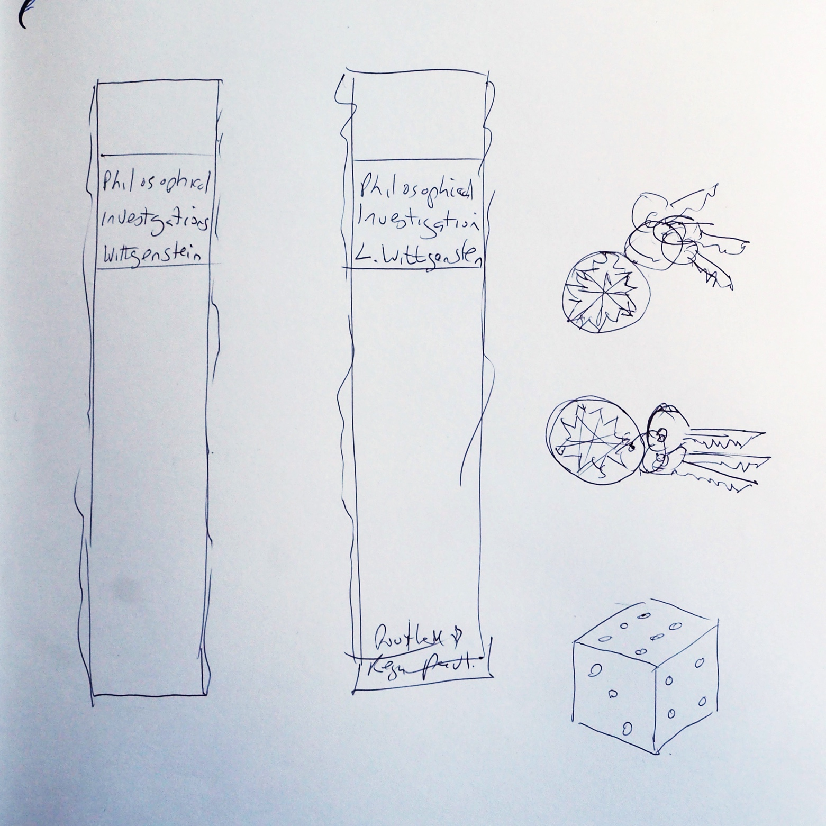
Quick line drawings from memory of semi-lost objects hiding in drawers and cupboards.

Slide 10
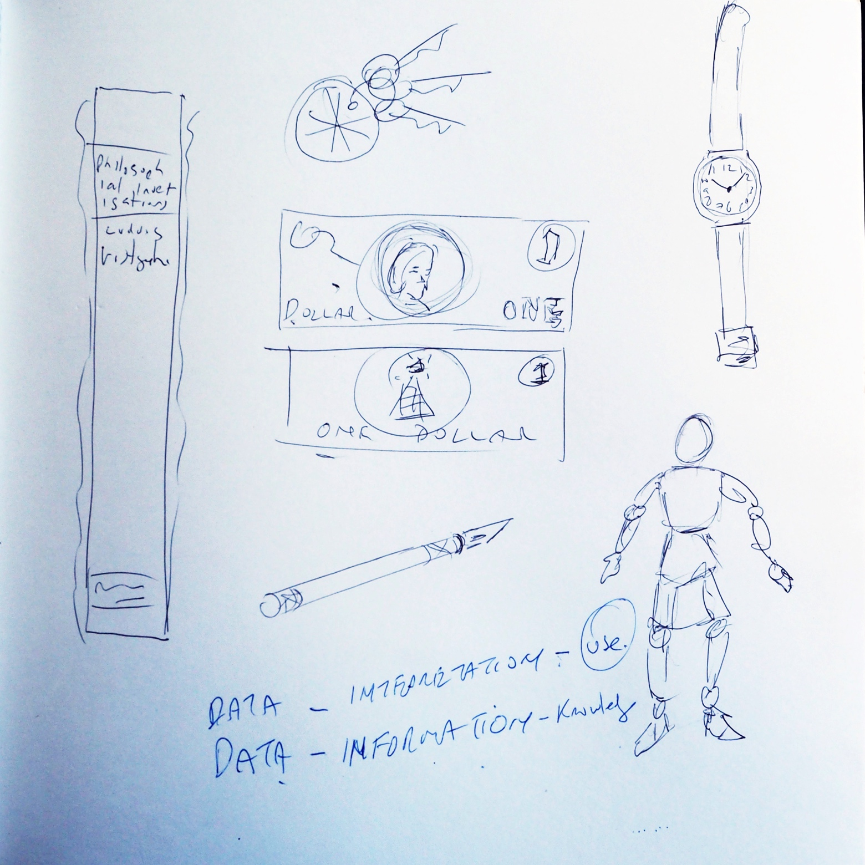
Quick line drawings from memory of semi-lost objects hiding in drawers and cupboards.

Slide 11
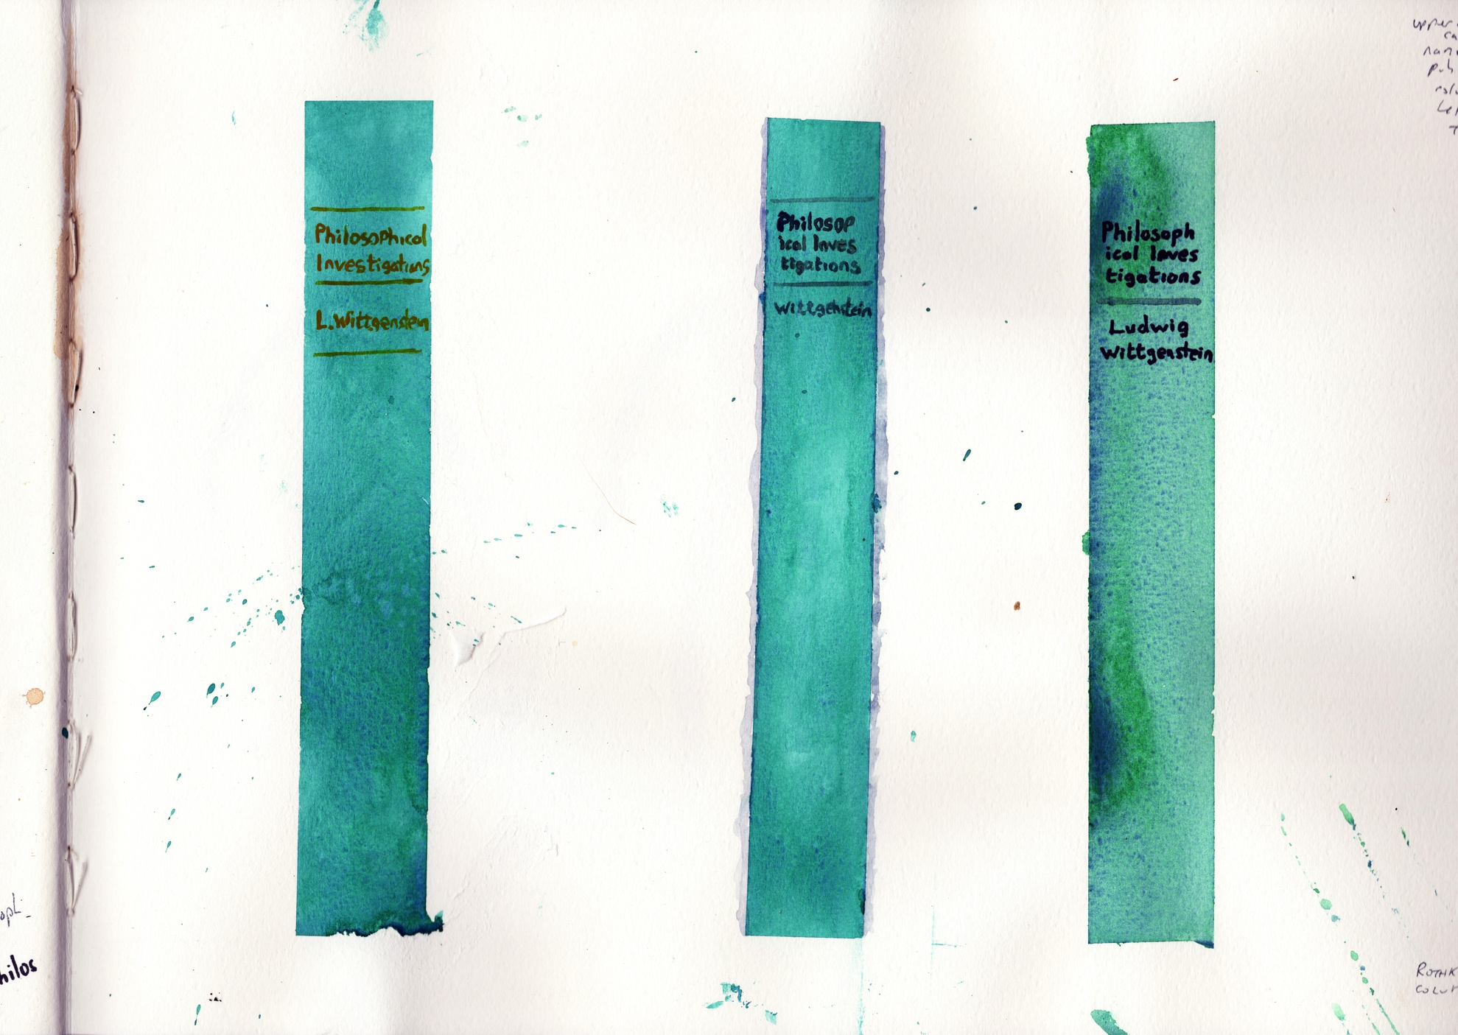
Colour sketches from memory of the spine of Philosophical Investigations

Slide 12
Method: After doing the color drawing from memory, I would find the object and compare it with my drawing. It was exciting to see what I had got right.
I then did a colour drawing from life, which enabled me to reflect on exactly how I had remembered wrongly or drawn badly. This was a crucial step because sometimes even with the object in front of me I failed to draw crucial detail, simply because it was hard to draw (eg rounded corners on die, oak leaf design on US dollar).
I repeated this process for six of the objects shown in the slides.

Slide 13
Colour drawing from life of the spine of Philosophical Investigations

Slide 14
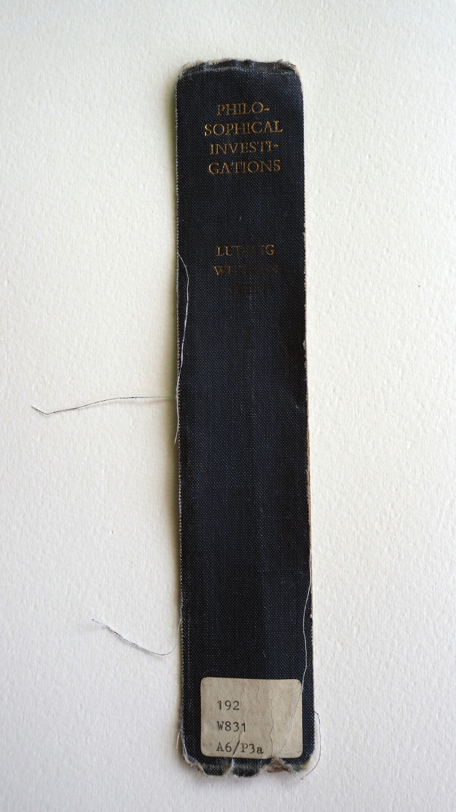

Slide 15
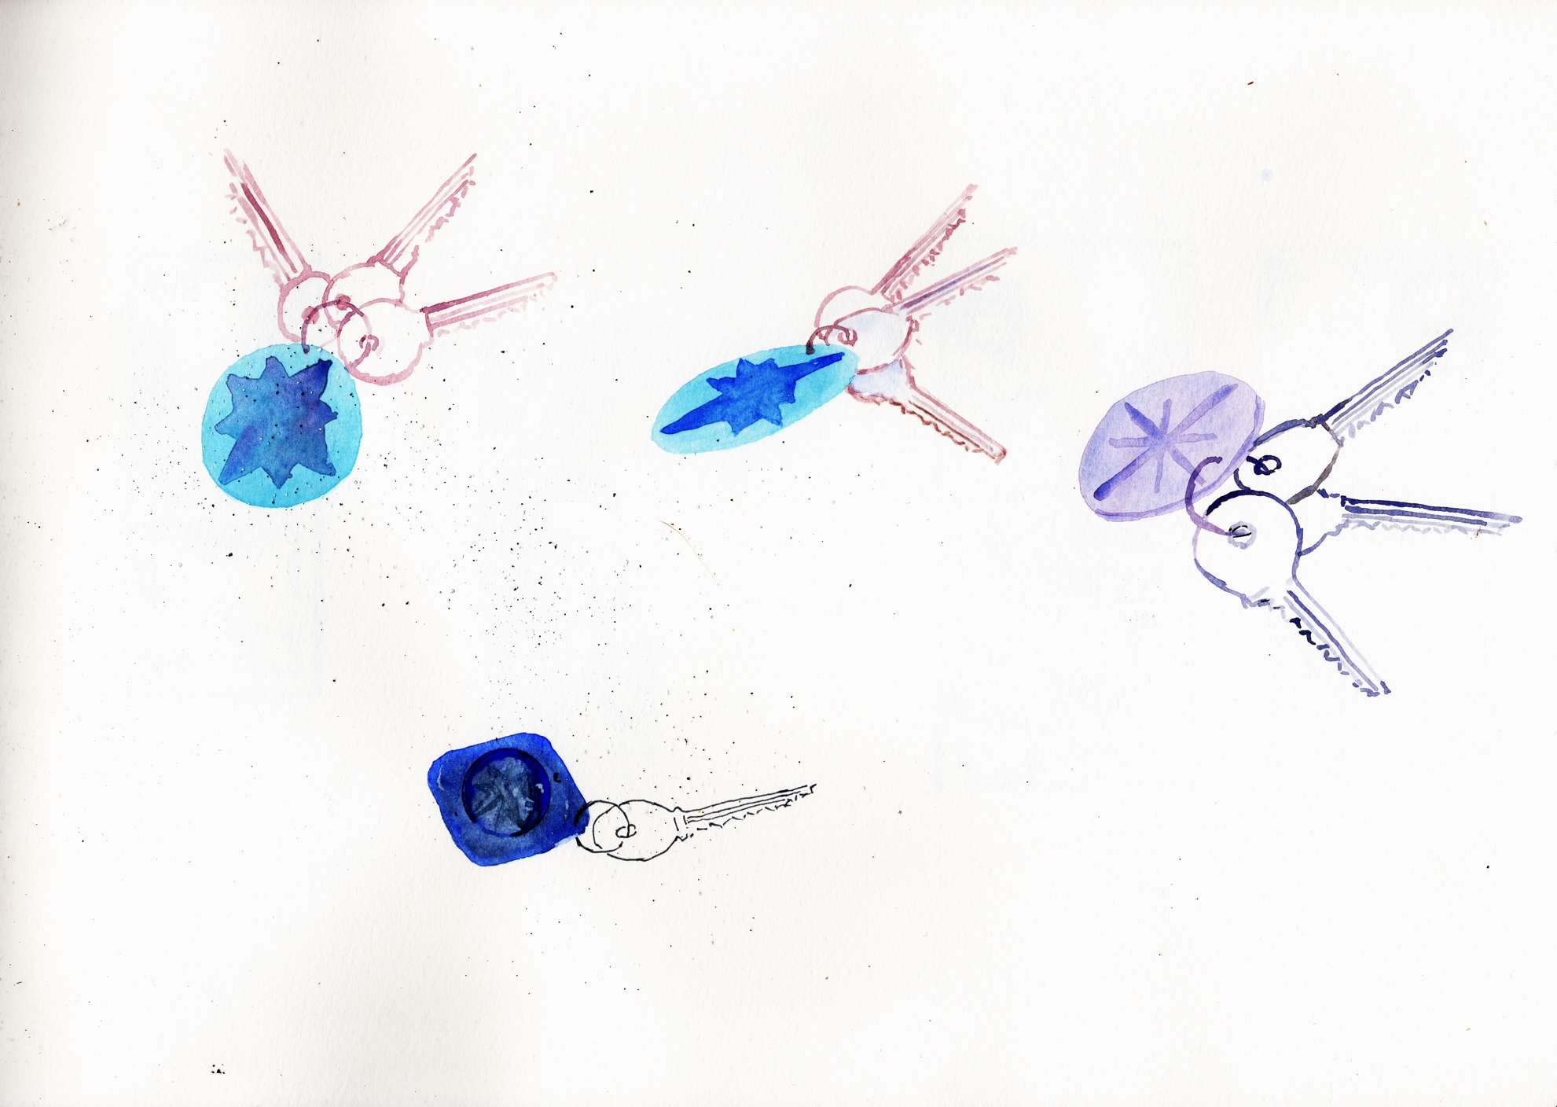
Colour sketches from memory of the set of keys with a compass logo on the fob.

Slide 16
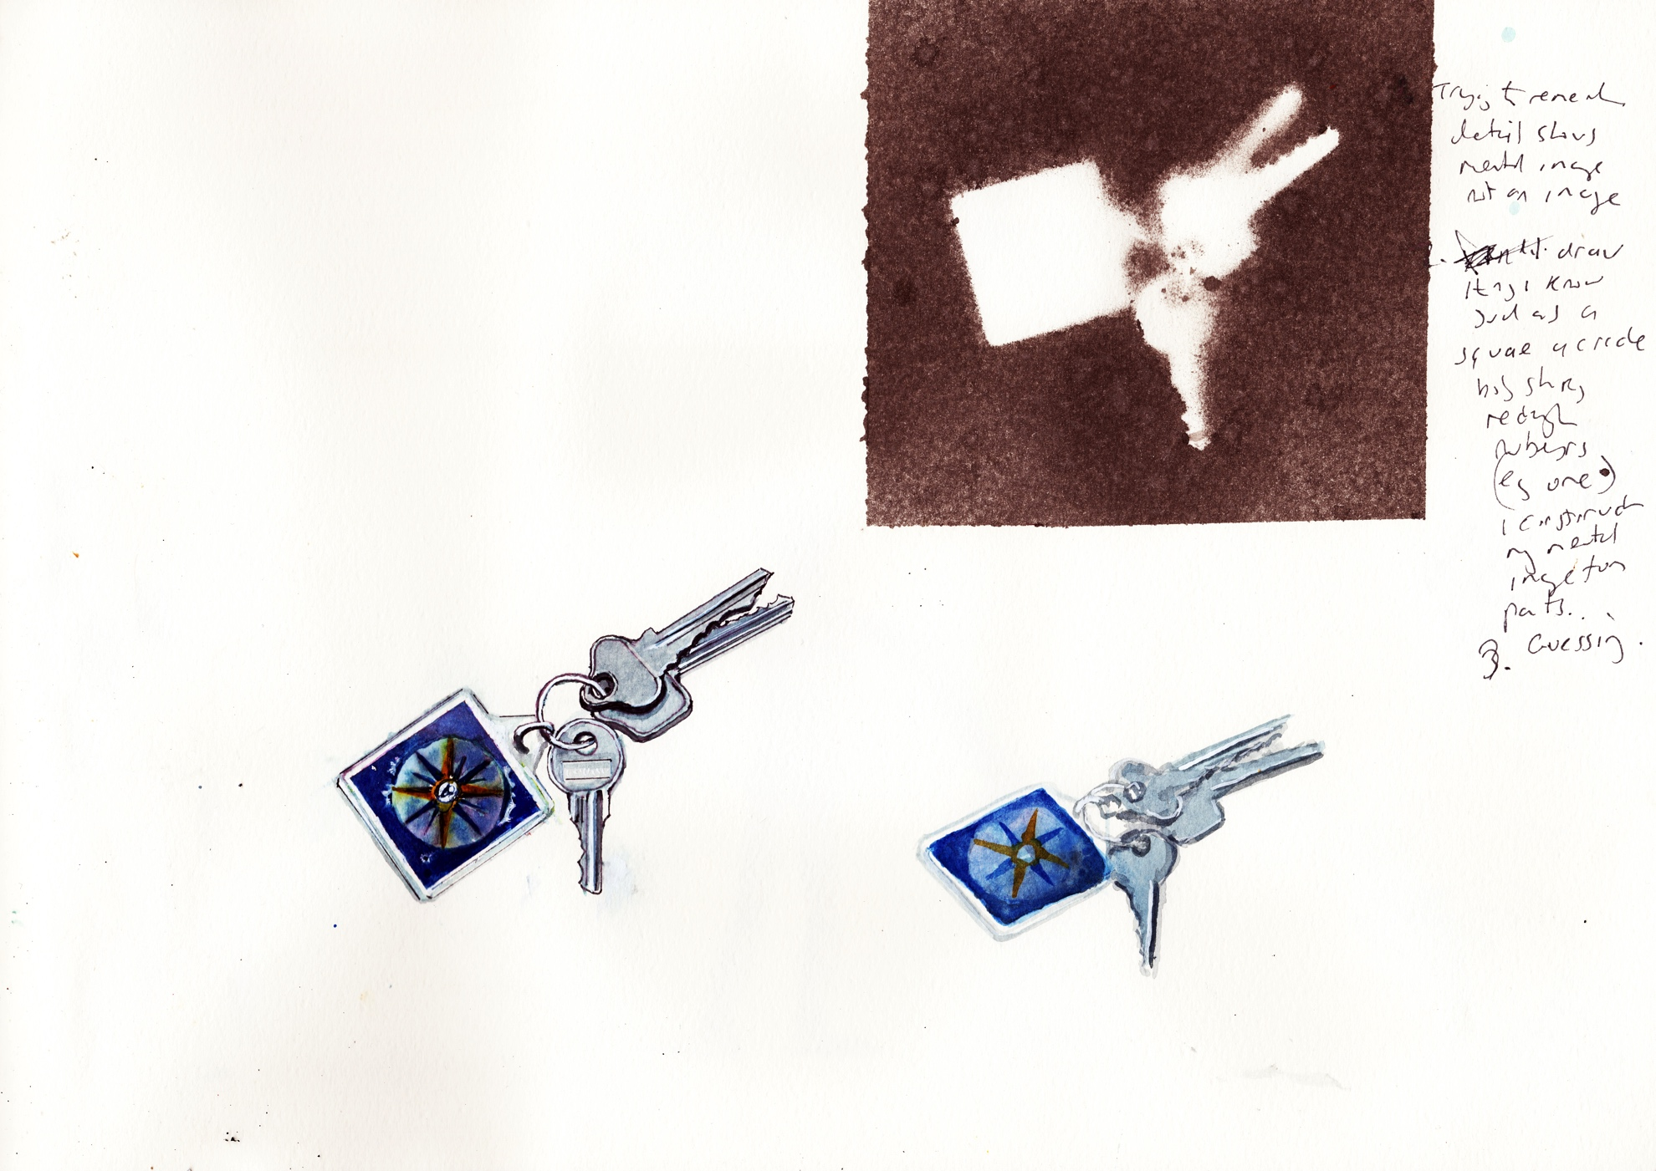
Colour drawings from life of the set of keys with a compass logo on the fob.

Slide 17
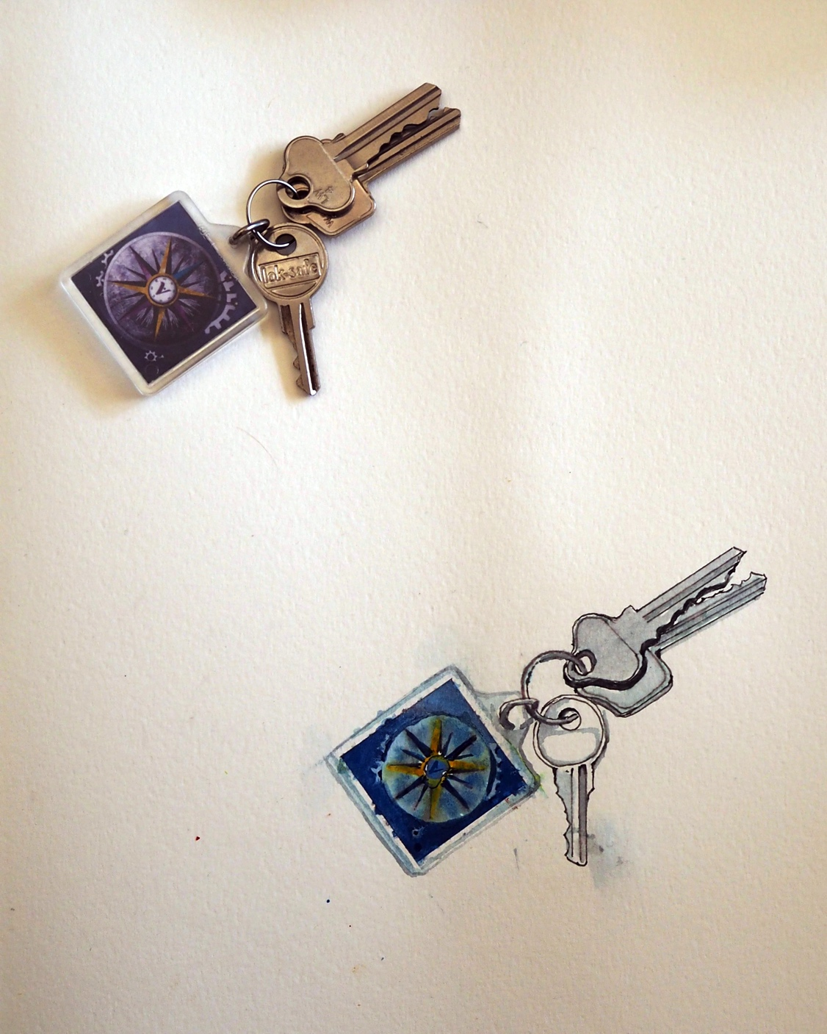

Slide 18
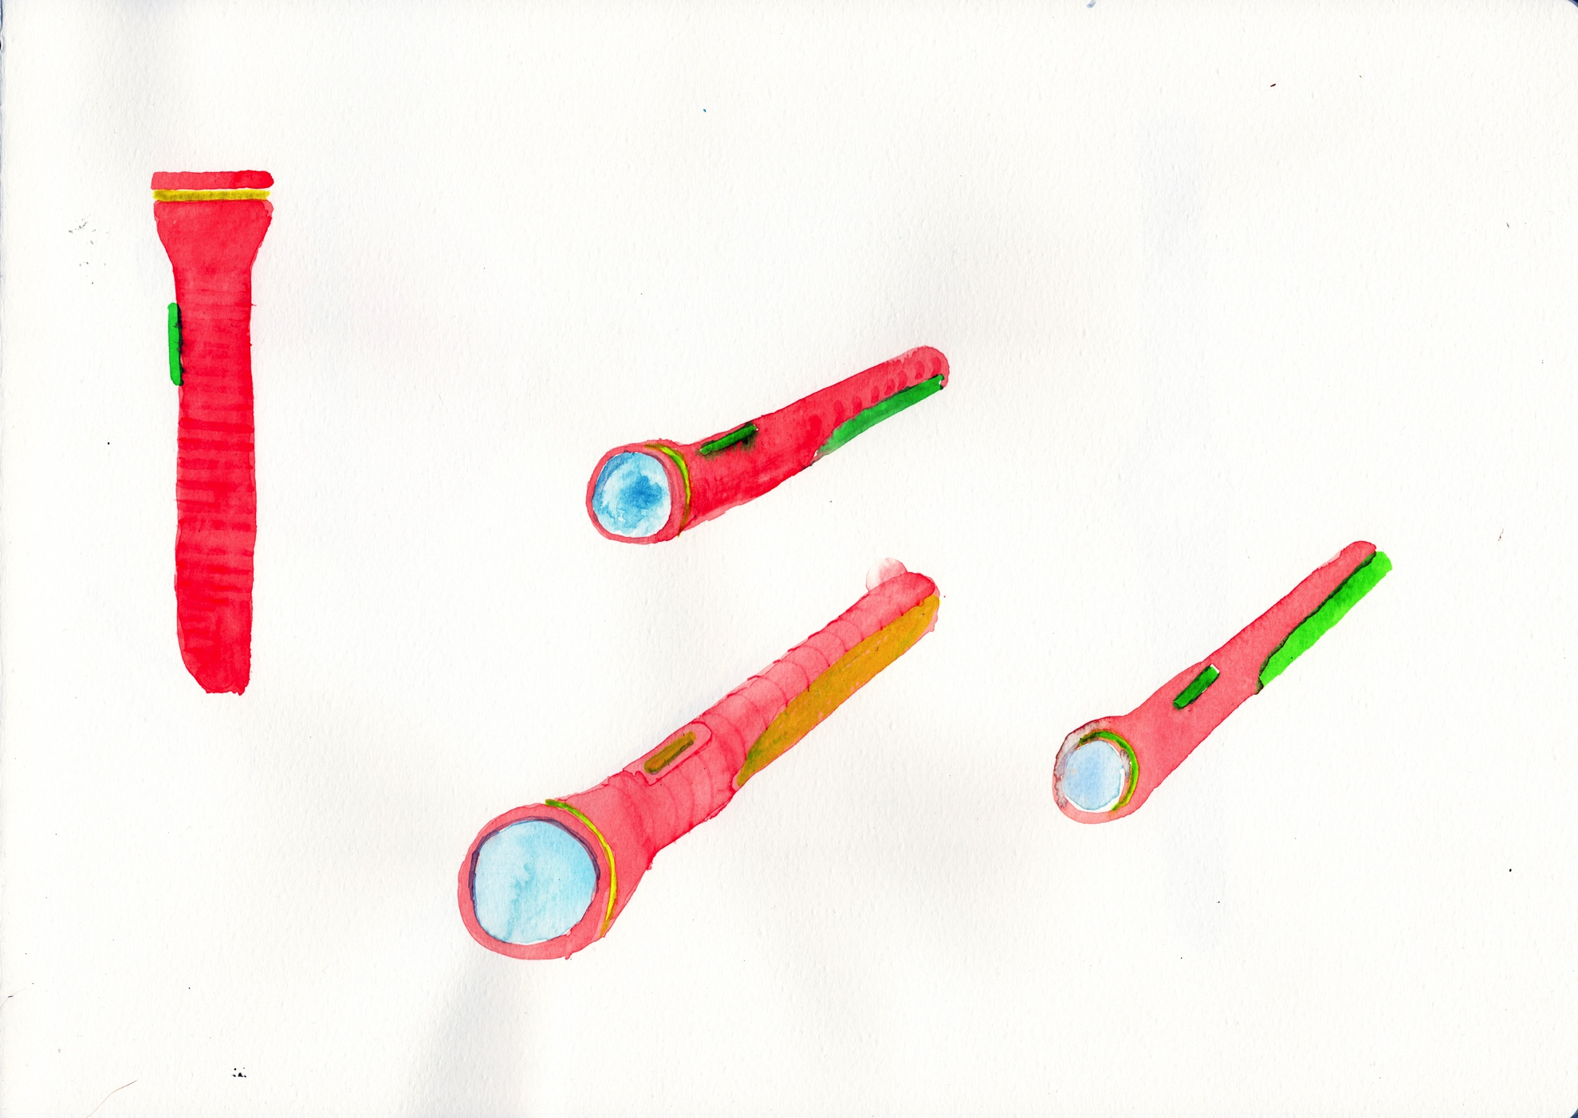
Colour sketches from memory of a torch

Slide 19
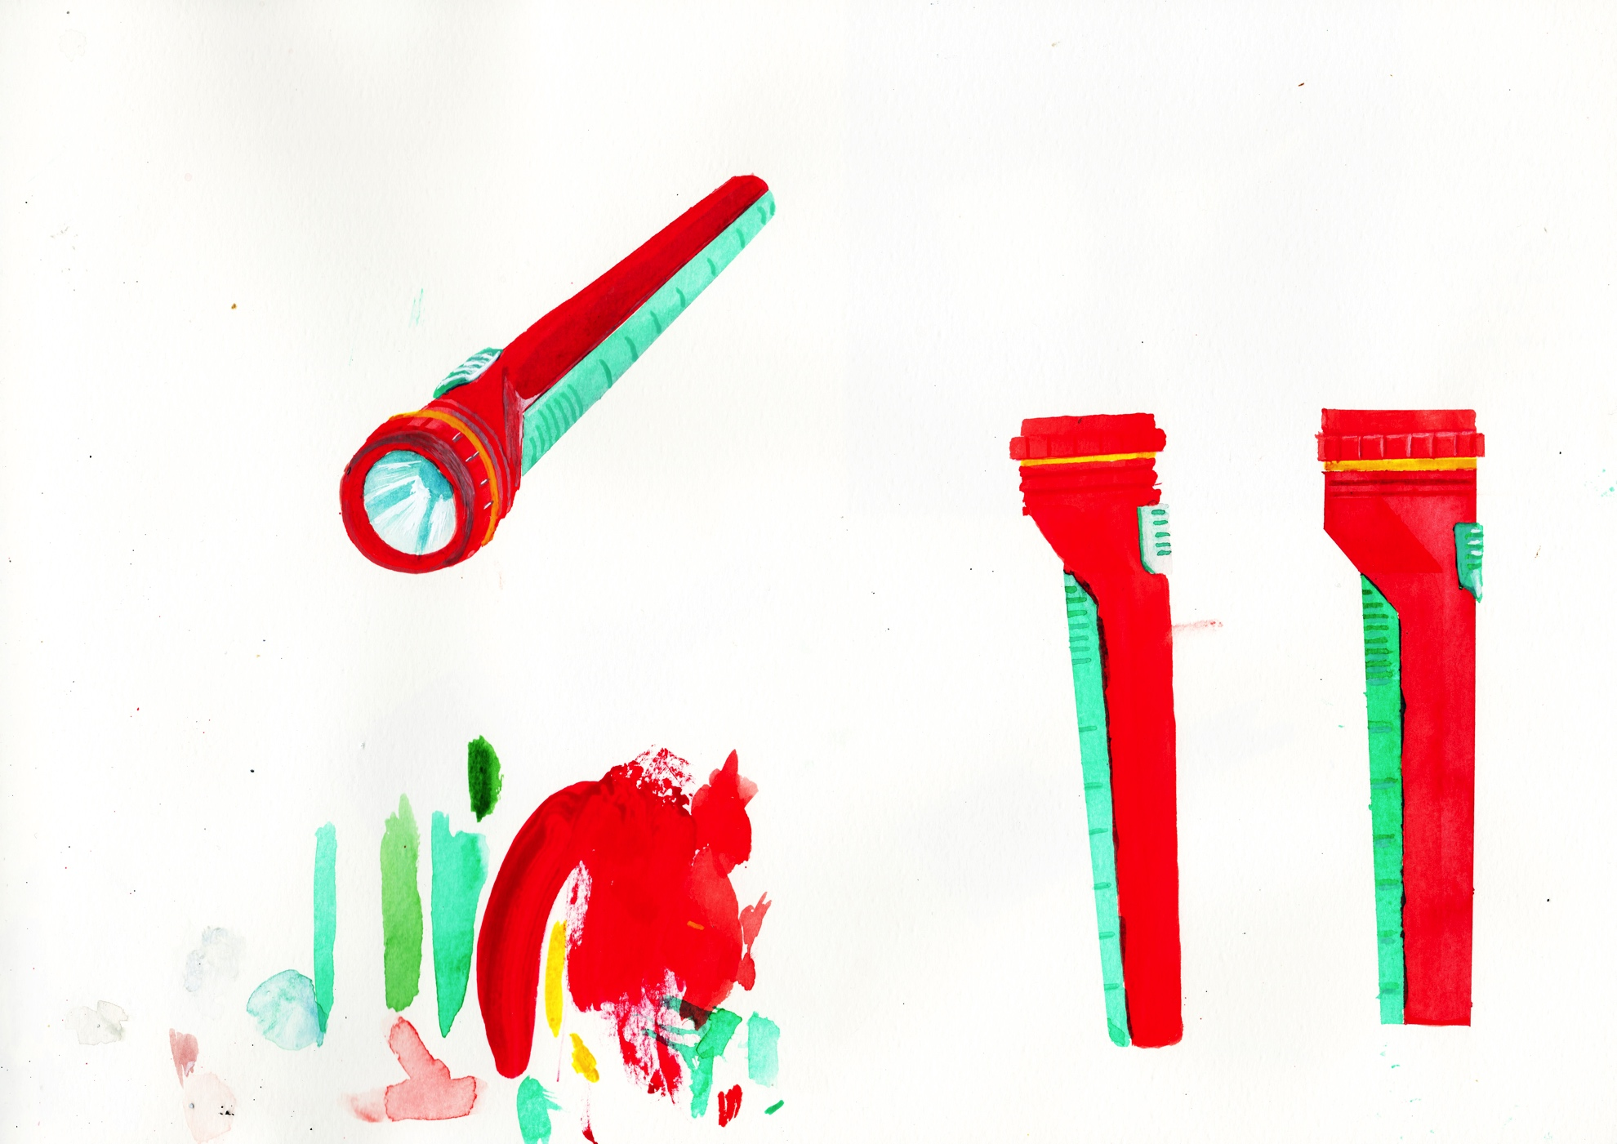
Colour drawings from life of a torch

Slide 20
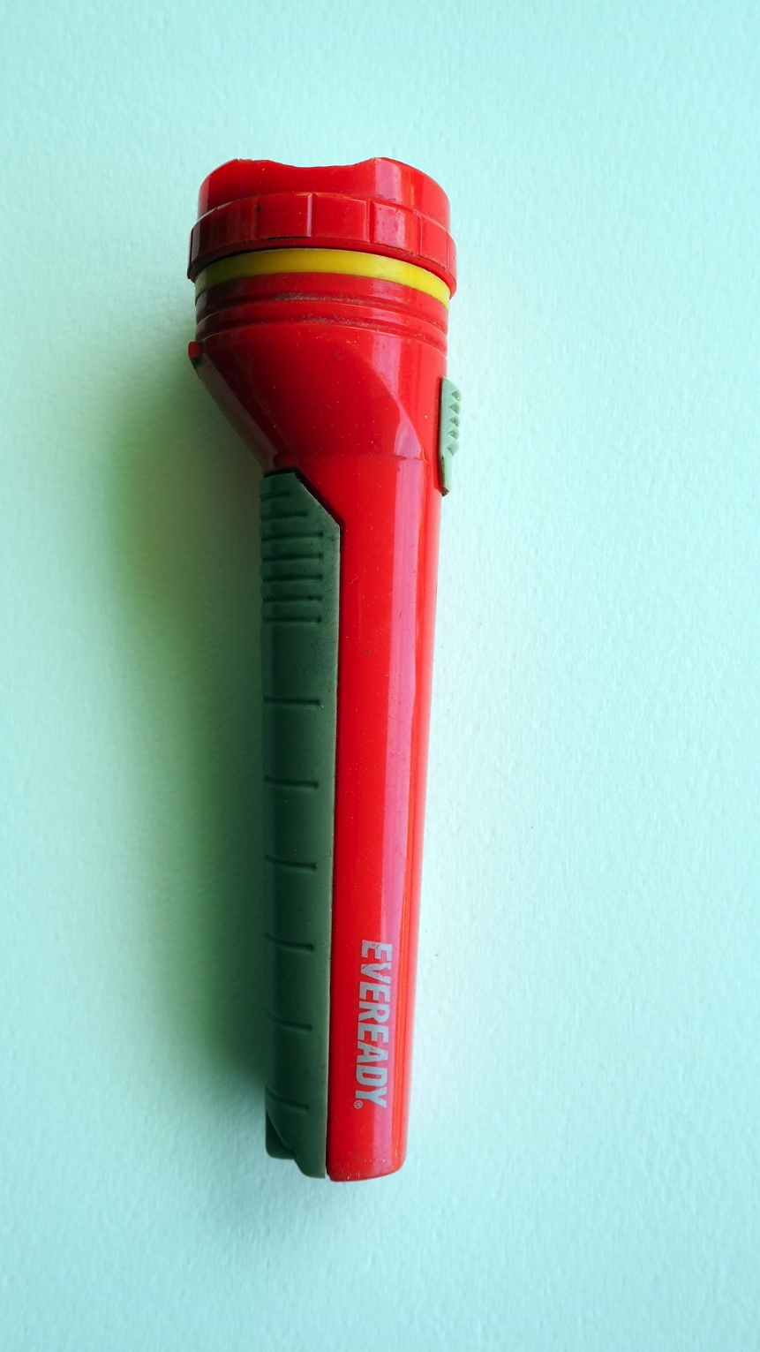

Slide 21
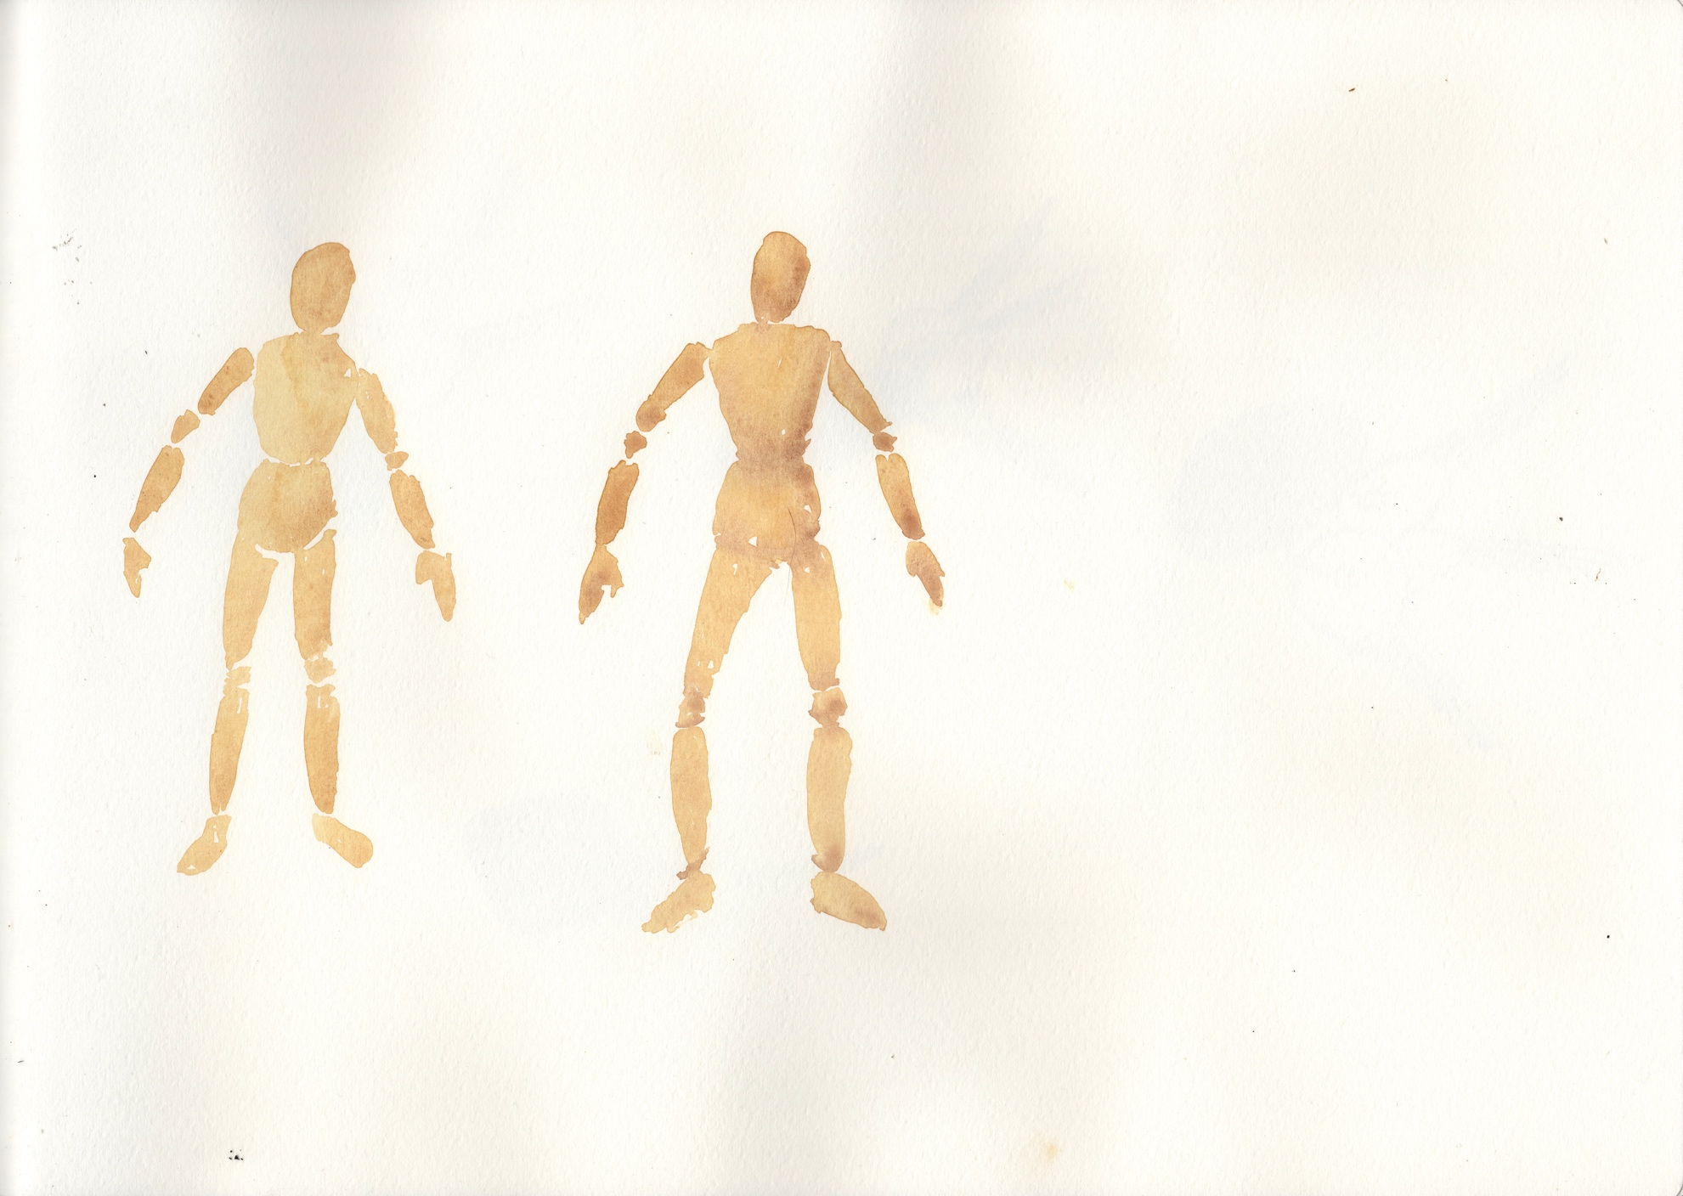
Colour drawings from memory of a wooden mannequin

Slide 22
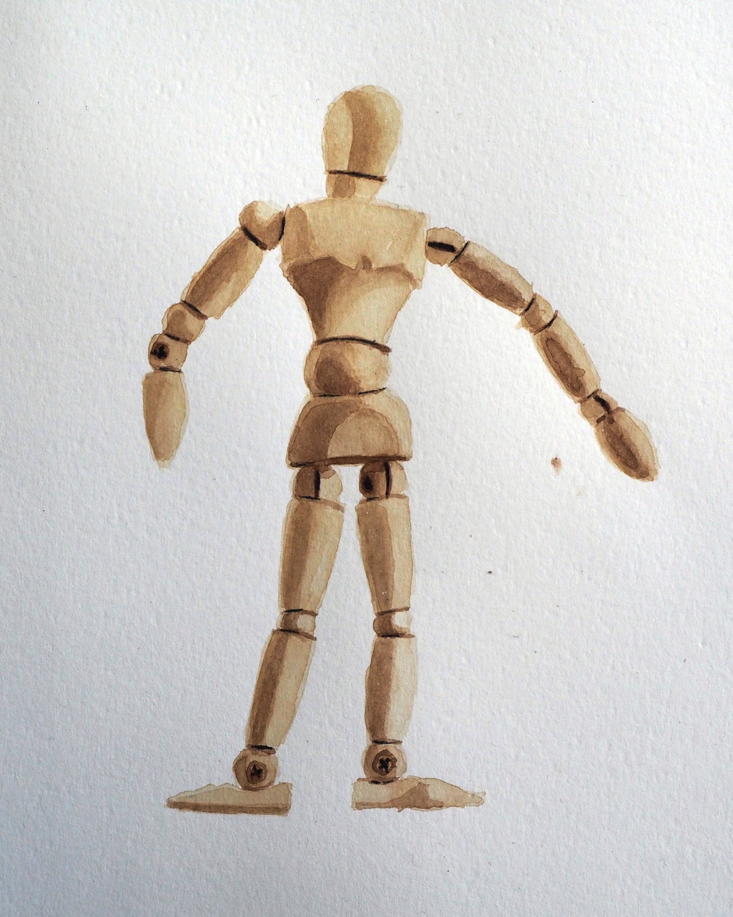
Colour drawing from life of a wooden mannequin

Slide 23
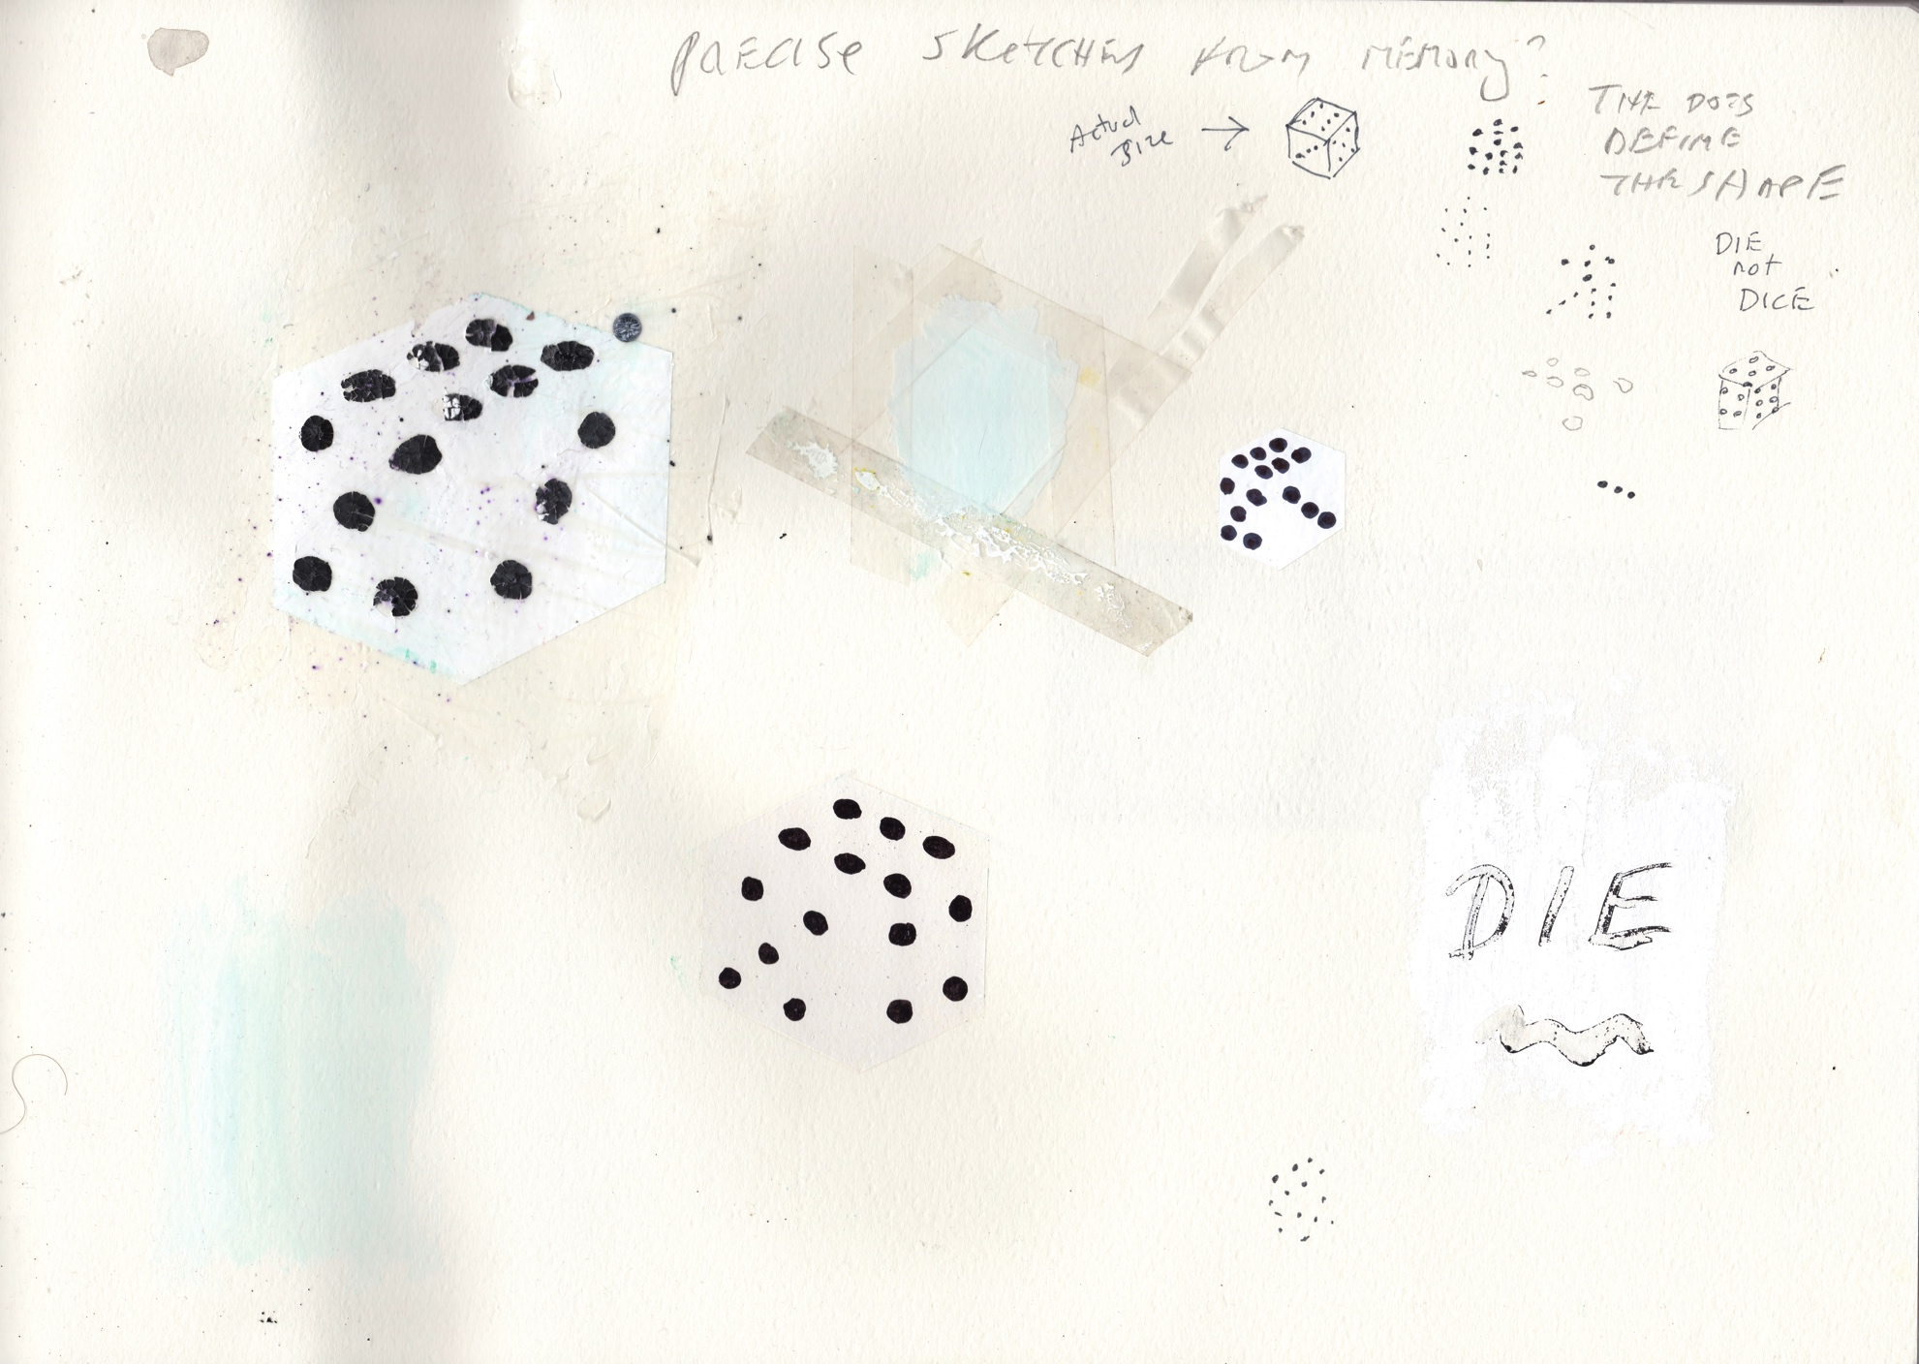
Colour sketches from memory of a die

Slide 24
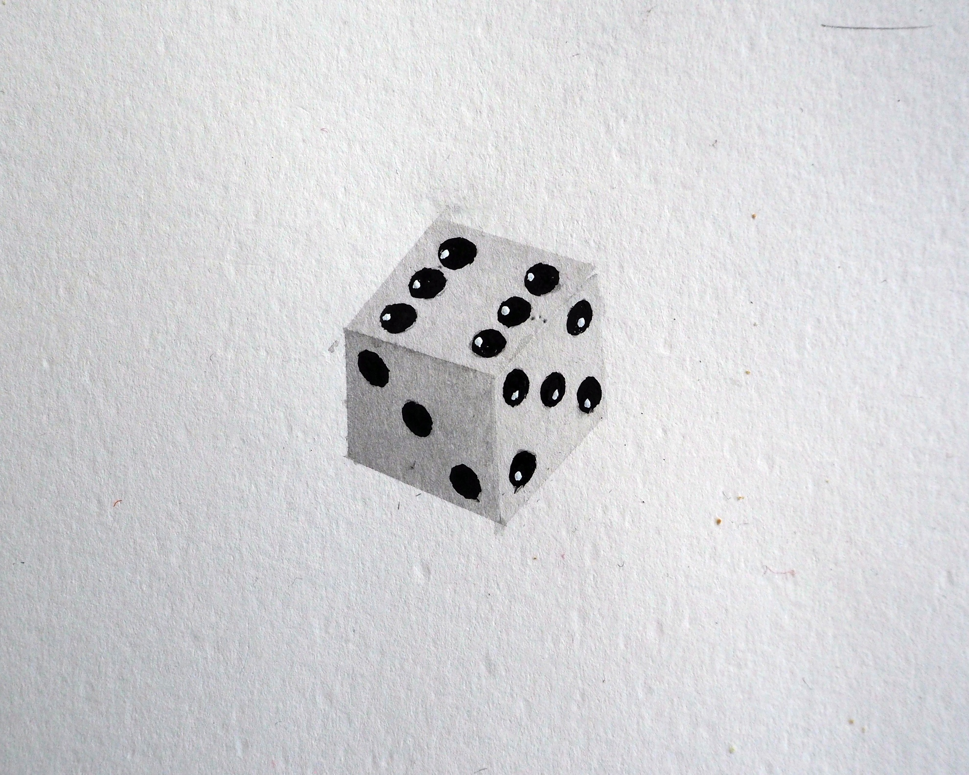
Colour drawing from life of a die

Slide 25
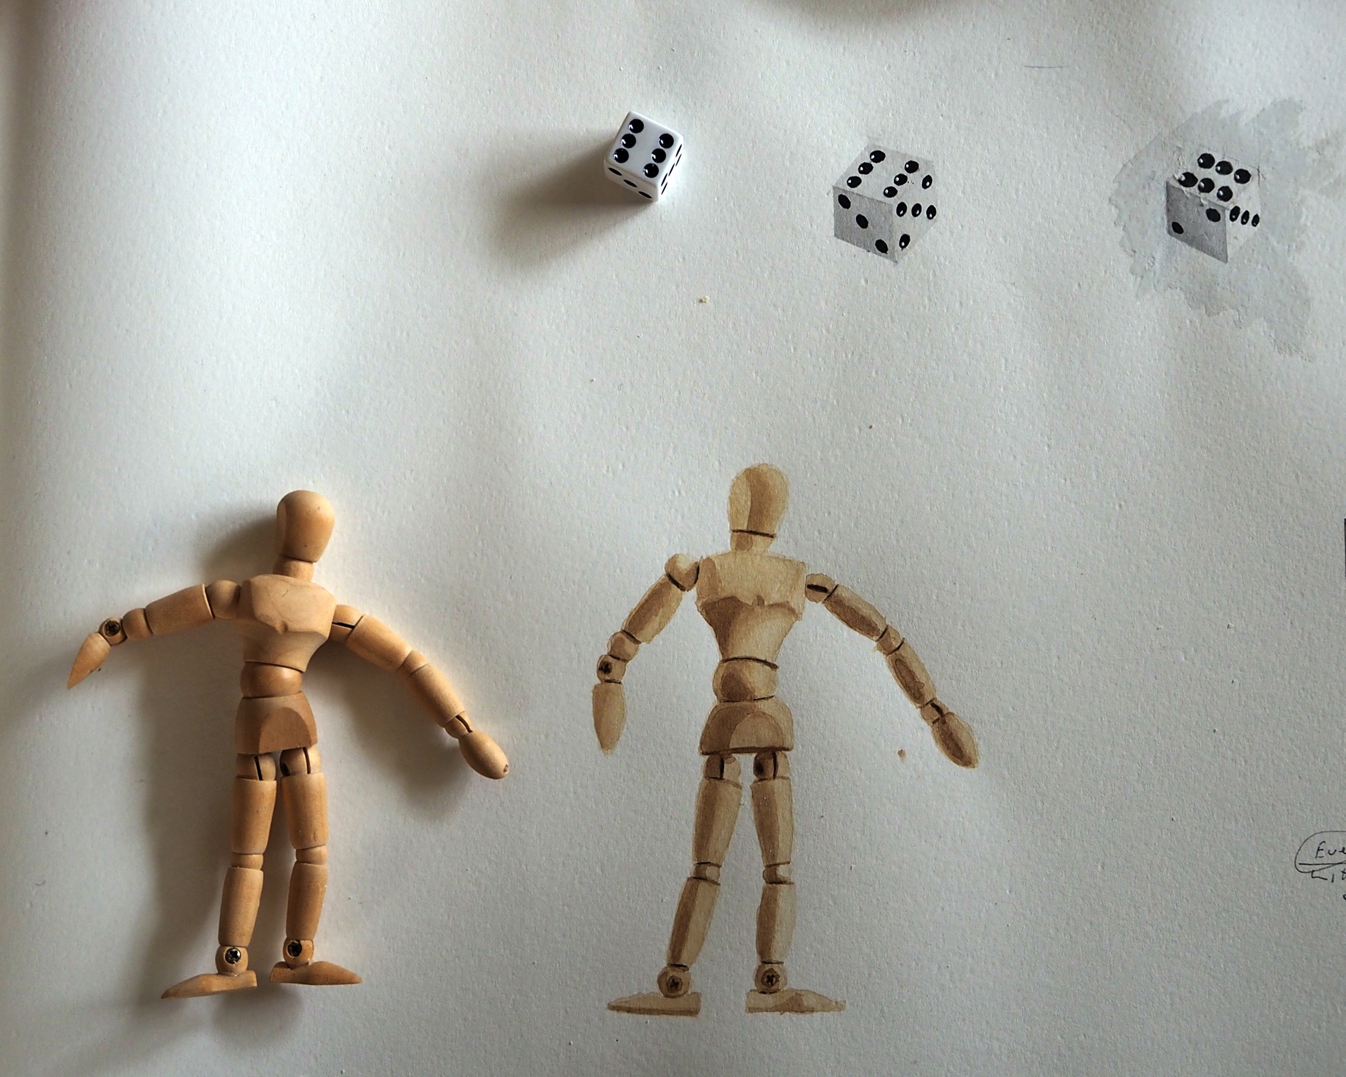

Slide 26
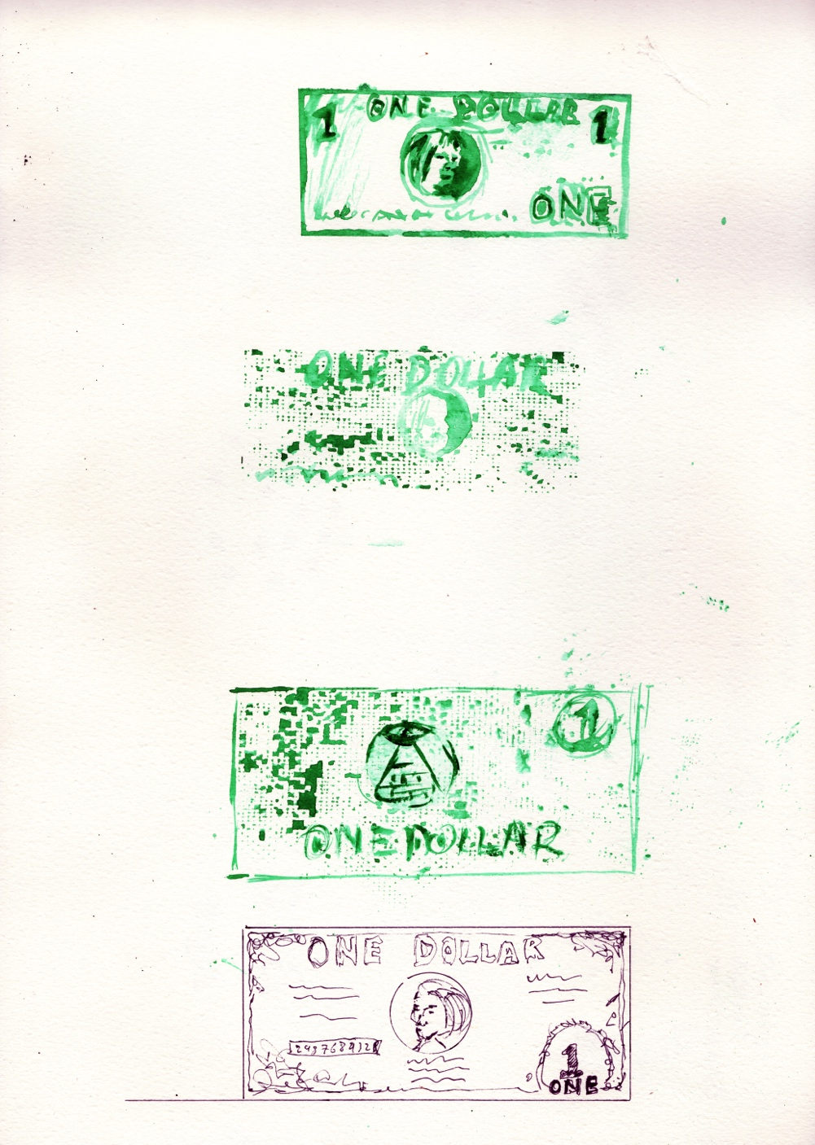
Colour sketches from memory of a US Dollar

Slide 27
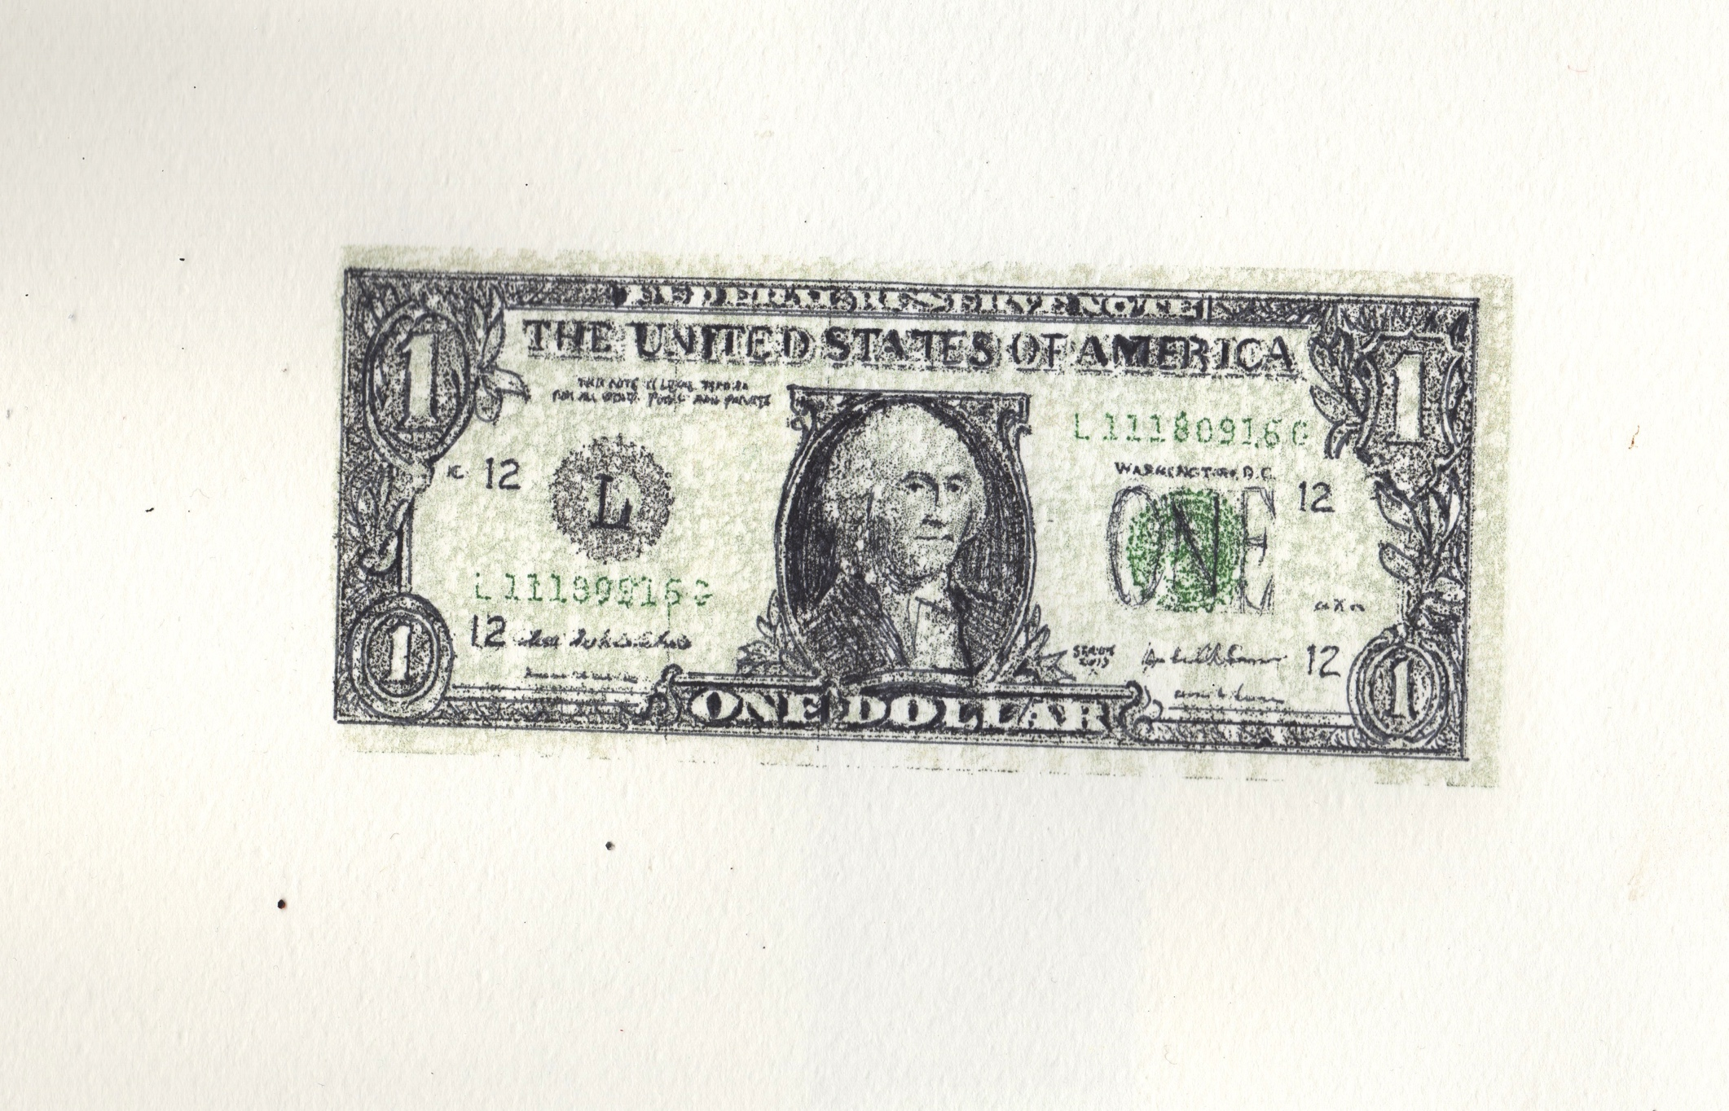

Slide 28
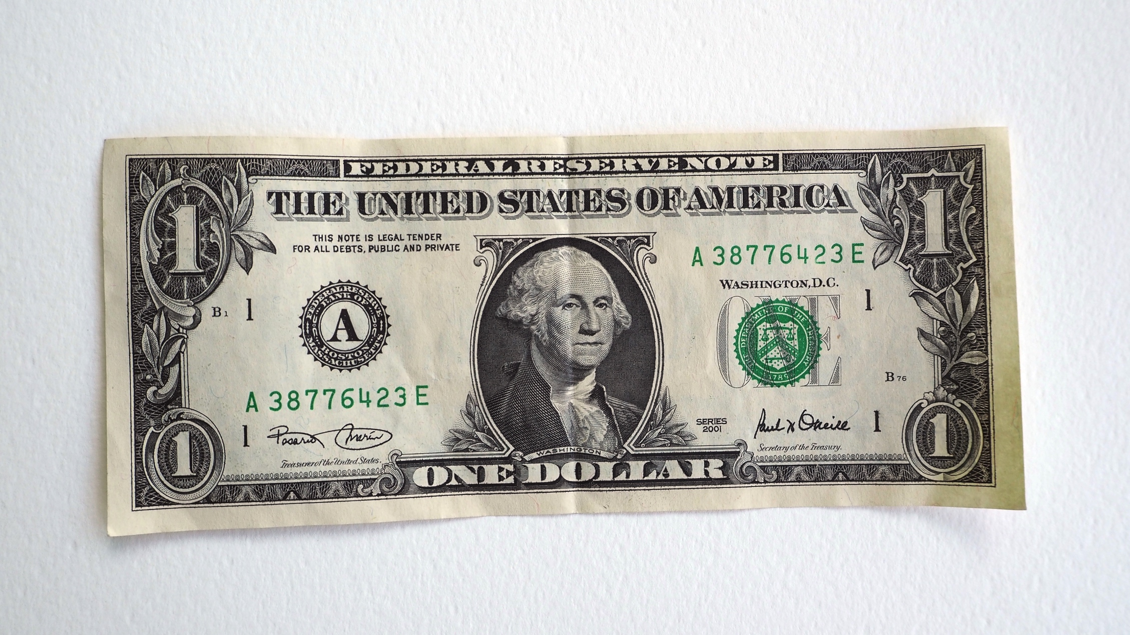

Slide 29
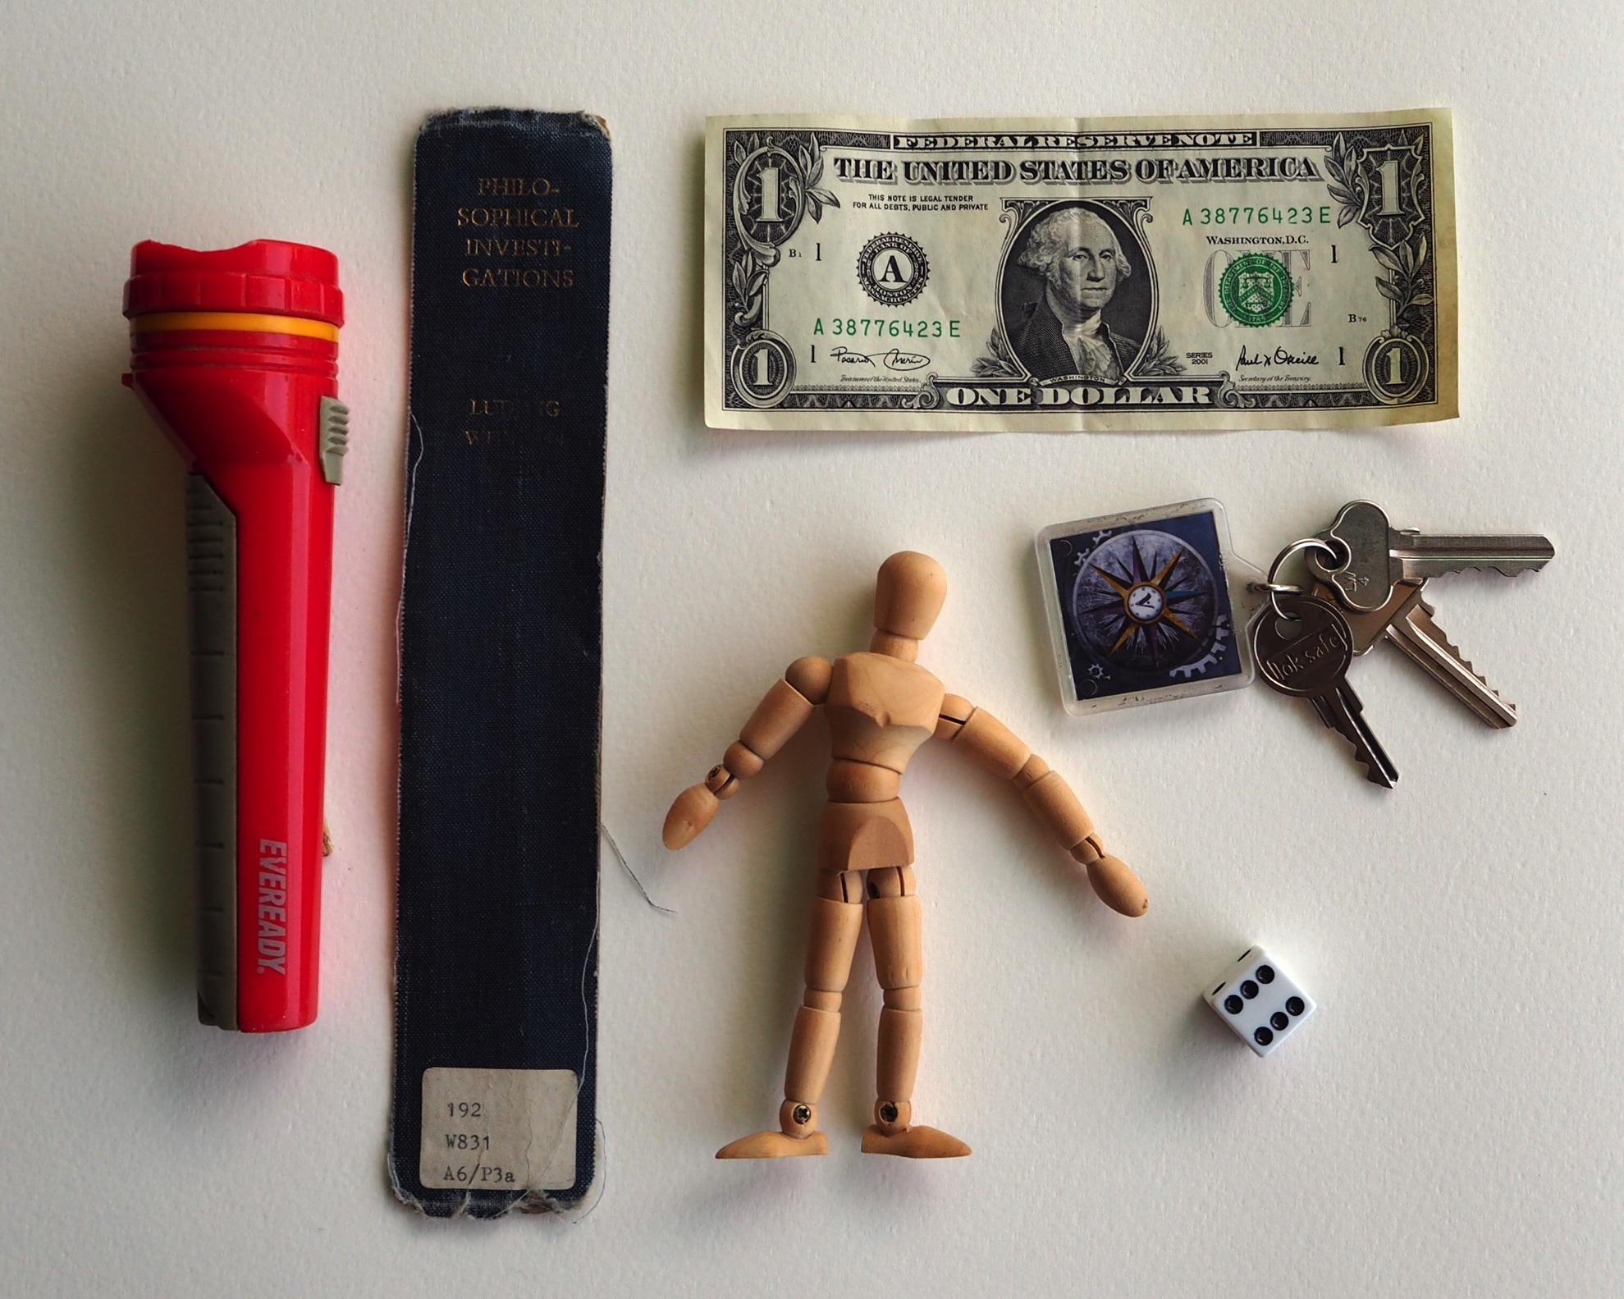

Slide 30
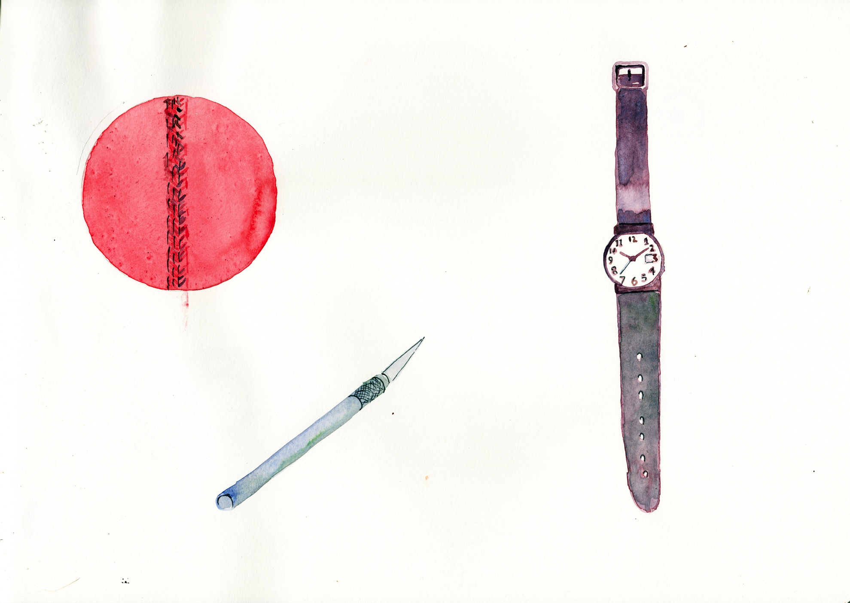
Colour sketches from memory of a cricket ball, a scalpel and a Swatch.

Slide 31
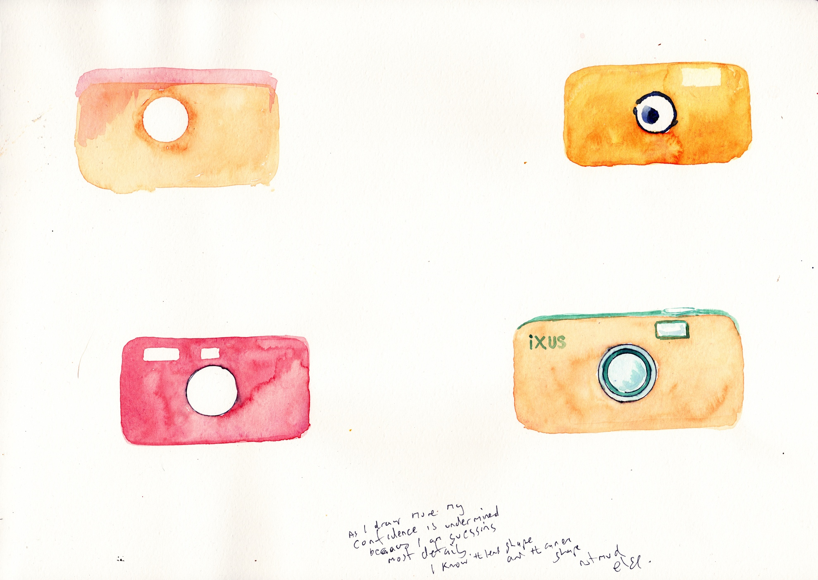
Colour sketches from memory of a Canon Ixus

Slide 32
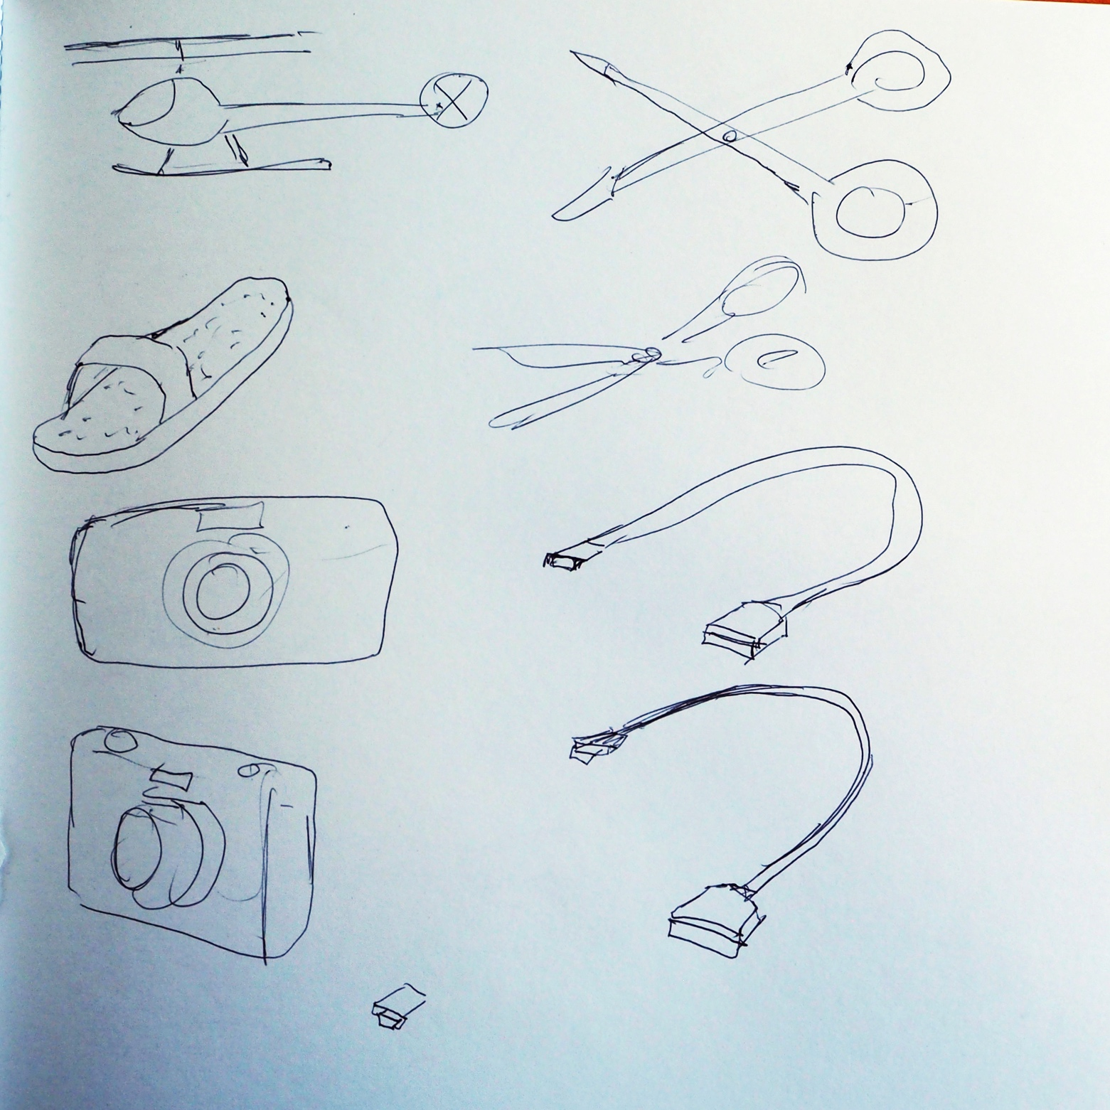

Slide 33
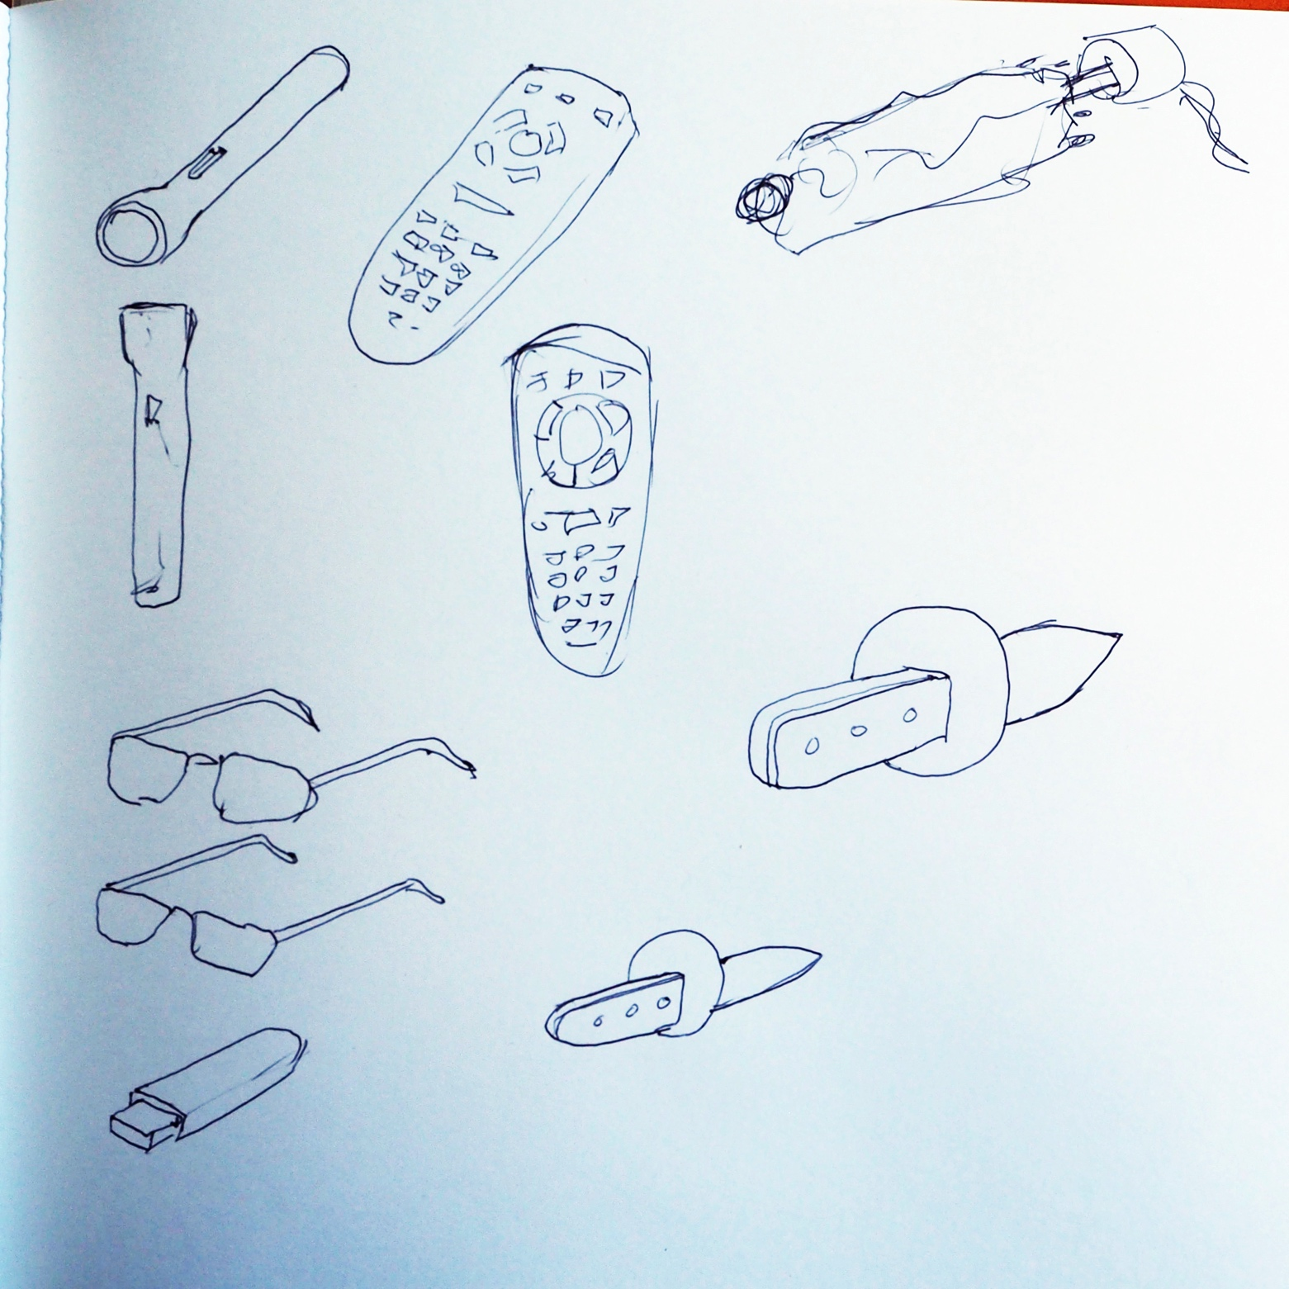

Slide 34
NOTES ON ISSUES WHICH AROSE WHILST DOING THE DRAWINGS
Philosophical Investigations Book Spine
Title split – how is it split?
‘Ludwig Wittgenstein’ somewhere, but where?
Upper or lower case
What colour are the letters?
Is the publisher name on spine?
Things I missed or got wrong
Missed: Library Dewey code and label
Wrong: I wasn’t sure about the colour of the lettering
Wrong: I sometimes included ‘Ludwig Wittgenstein’ but in fact his name has been largely erased from the spine.
Keys
Number of keys?
Shape of fob?
Shape of keys?
Detail in compass?
Things I missed or got wrong
Missed: Fob key ring connector.
Missed: Detail of compass – I thought it was sparse – it is very detailed.
Wrong: Shape of fob – it is square, not round.
Wrong: Shape of keys – they are all different shapes.

Slide 35
Torch
Canonical view?
Two tone – how configured?
Things I missed or got wrong
Missed: ‘EVEREADY’
Missed: Crenulations on ring at top of torch.
Wrong: I didn’t get the two-tone configuration right.
Wrong: Grip crenulations in wrong part of torch.
Wrong: Overall shape, especially size of torch ‘bell’ compared to cylinder body.
Mannequin
Had drawn it before?
Things I missed or got wrong
Missed: Detail of how joints are jointed.
Wrong: Shape of head and chest and pelvic area.
Die
The perspective on the spots defines the shape.
How are the spots configured around the die?
Problem of white against white.
Simple object – cube with spots on. It’s hard to draw simple things well.
Things I missed or got wrong
Missed: Rounded corners
Wrong: Size of spots.

Slide 36
US One Dollar
Where is the lettering? Top bottom?
Where is the number ‘one’ – is it spelled out?
Where are the serial numbers?
Things I missed or got wrong
Missed: Lots of detail – including “THE UNITED STATES OF AMERICA”
Wrong: In my sequence of drawing I tended to get one or two things right and everything else wrong. It was always a guess.

Slide 37
General Observations
The more detail I added in the colour sketches from memory the more I felt that everything was a guess and there was no point in going into detail.
I couldn’t decide whether to present the object in a canonical view (eg side on, three-quarter). It was hard to decide which view showed features in the best way. That is why I sometimes did multiple views. (Note: although I was drawing an object I had last seen in a drawer partially occluded by other objects, I was note consciously visualizing the object in the drawer.)
I decided the draw the objects same size. Not sure why.
Each iteration of a drawing brought to mind a new issue/solution. Drawing is a good way of provoking visual memory.
Difference between identifying a feature and distinguishing a feature.

